Slide 1
WORK IT! YOUR LEARNING IN ACTION STARTS HERE

Slide 2
YOU ARE HERE
??
????
1
3
5
2
4
6
?
???
GRADUATION AND SUCCESS!

Slide 3
What are you most excited for on your path to graduation?
ⓘ Start presenting to display the poll results on this slide.

Slide 4
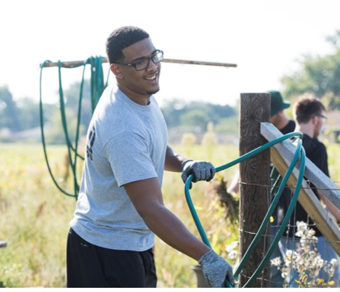
EXAMPLES
Internships
Campus employment
Community-based learning (CBL)

Slide 5
Internships

Slide 6
Performance evals/reflections
Professional setting
Supervised work experience
Discipline related
Career relevant learning
What is an
internship?

Slide 7
Internship Options
Paid vs. unpaid
Summer/semester/continuing
Part time vs. full time
Academic credit
Potential for permanent employment

Slide 8
Campus Employment

Slide 9
Benefits of Campus Employment
Flexible and convenient (right here on campus!)
Hands-on work experience
Personal and intellectual development
Take on leadership positions

Slide 10
Student Employment Positions in…
Admissions
Advising & Career Center
Campus Concierge
Campus Activities & Engagement
Campus Technology Services
Creative Services
Disability Services
Dining Services
Housing & Residence Life
Library
Marketing and Communications
Parkside Academic Resource Center (tutoring)
Production Services
Student Center

Slide 11
What Employers Say
78%
Employment no longer depends solely on degree or academic major, but more on
experience, practical sense, and ability to do the job

Slide 12
Find them on
Watch your Ranger email for an invitation to join Handshake!

Slide 13
Community-based learning (CBL)

Slide 14
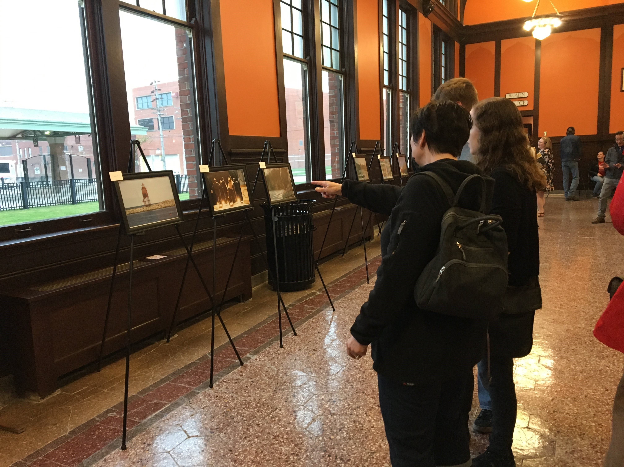
Organized service activity
Connected to course learning outcomes
Teaches civic responsibility
Helps solve community problems

Slide 15
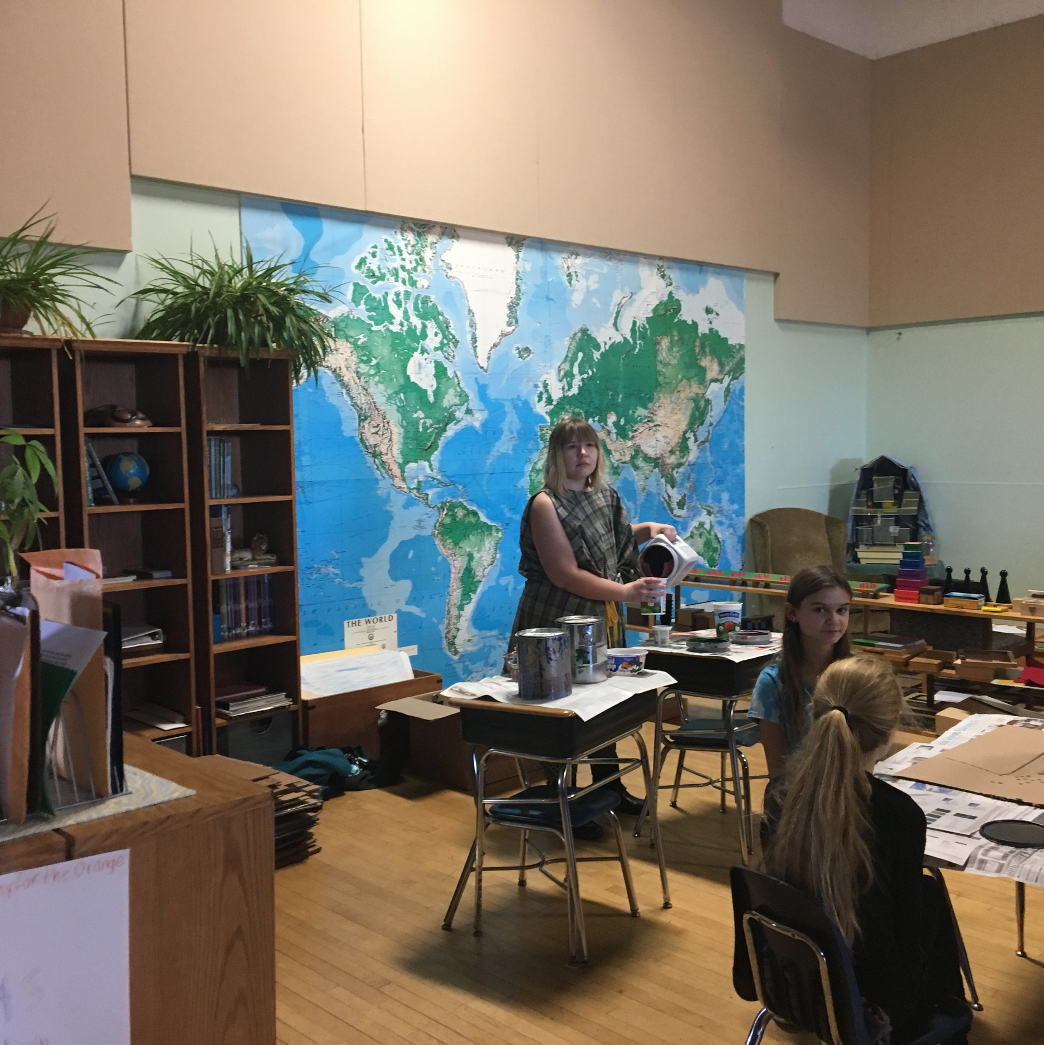
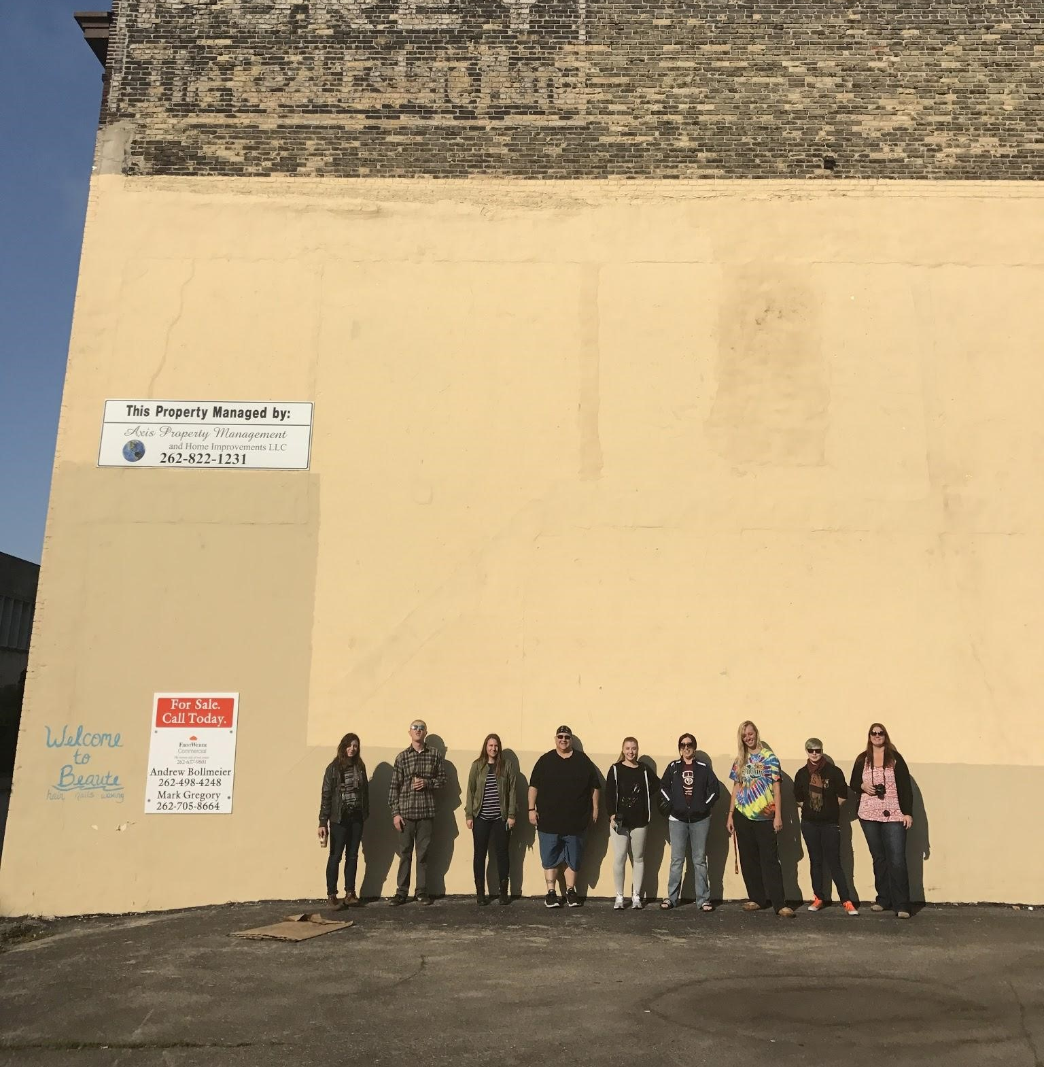
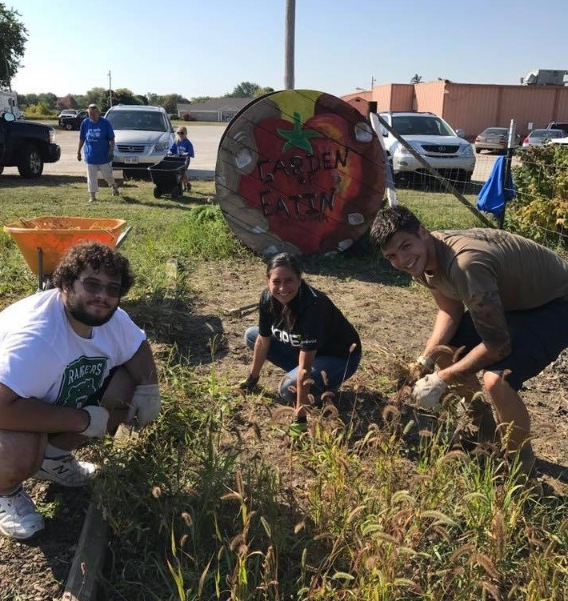
Theater Student at
the Racine Montessori School
Art Students Designing a Mural on a Downtown Racine Building
Sport & Fitness Nutrition Students at the Garden of Eatin’

Slide 16
Students who take CBL courses are
1.5x more likely to graduate.

Slide 17
What students say
94%
CBL project enhanced their ability to communicate in real-world settings
92%
Community project helped them gain skills for future employment

Slide 18
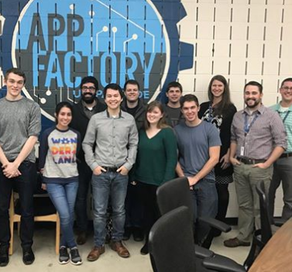
“
My work at the App Factory has taken me from a novice to one of the most proficient programmers on campus. I can do homework and school projects but it’s completely different than actually working for a real-life company and doing real-life work.
- Kyle Zawacki, Computer Science Student

Slide 19
PROJECTS
Research
Marketing and strategic plans
Graphic and web page design
Database design
Security audits
GIS mapping
Communication plans
Personnel training
Conflict resolution
And more every year!

Slide 20
Community Engagement Certificate

Slide 21
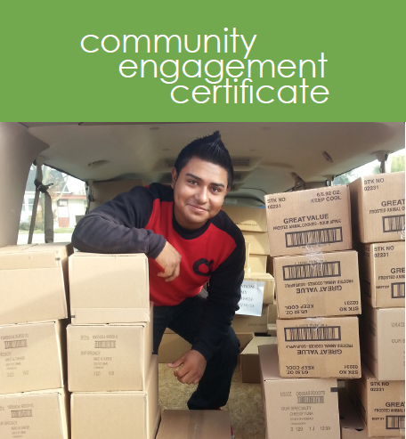
Community Engagement Certificate
CBL 101 (3 Credits)
9 CBL Elective Credits
CBL 495 Capstone

Slide 22
Which Learning in Action opportunities would you like to explore here at Parkside?
ⓘ Start presenting to display the poll results on this slide.

Slide 23
Thanks!
You can find us in the
Alan E. Guskin Center for Community and Business Engagement Office
Kaila Bingen – bingenk@uwp.edu
Amy Garrigan – garrigan@uwp.edu
Debra Karp – karp@uwp.edu

Slide 24
Credits
Special thanks to all the people who made and released these awesome resources for free:
Presentation template by SlidesCarnival
Photographs by Unsplash

Slide 25
Presentation design
This presentation uses the following typographies:
Titles: Amatic SC
Body copy: Encode Sans Semicondensed
Download for free at: https://fonts.google.com/specimen/Amatic+SC
https://fonts.google.com/specimen/Encode+Sans+Semi+Condensed
You don’t need to keep this slide in your presentation. It’s only here to serve you as a design guide if you need to create new slides or download the fonts to edit the presentation in PowerPoint®

