Slide 1
Proactive Student Engagement Plan
August 2020

Slide 2
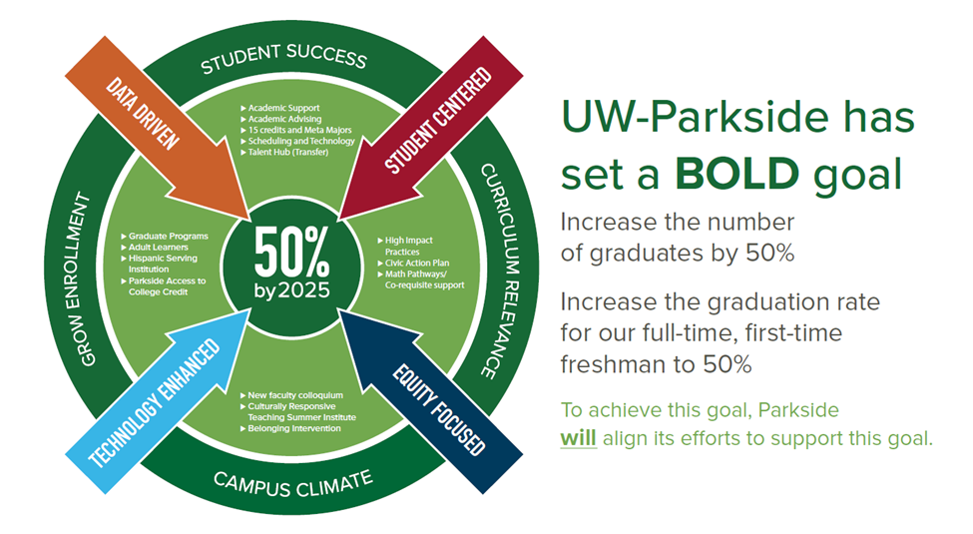
Notes:
So all of what I have shared really framed the establishment of our BOLD goal. And our work with Higher Expectations, Lumina, and other efforts really helped frame the priorities established in our academic plan. The image, highlight the 4 areas – student success, curriculum relevance climate and enrollment growth. In the center, the 50 percent reference is to visually indicate that students are at the center of the wok and the arrows show our commitment to equity, student centeredness, data and the use of technology to achieve our goals.. We have work underway in all areas. You are all aware of the efforts to diversify program offerings through increasing graduate and degree completion offerings. Today, I want to focus on how we grow enrollment through increased retention and ultimately improved graduate rates through our targeted student success efforts.

Slide 3
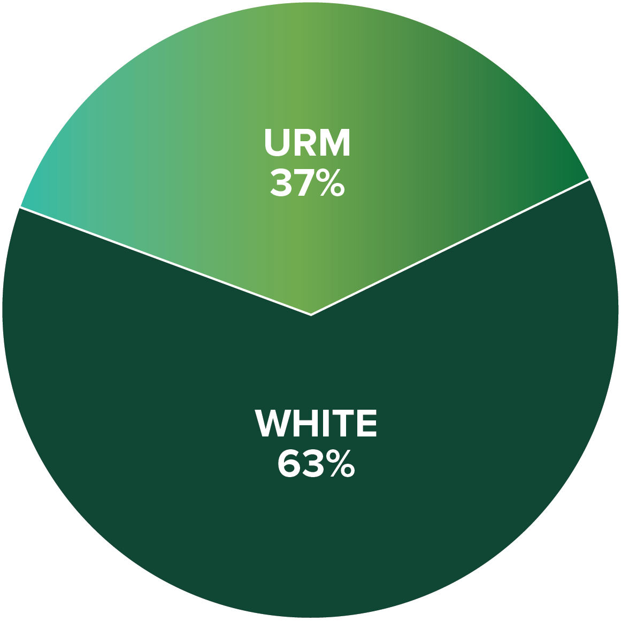
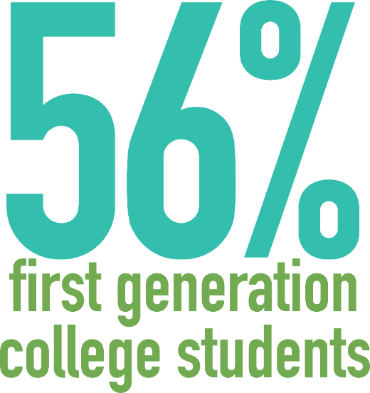
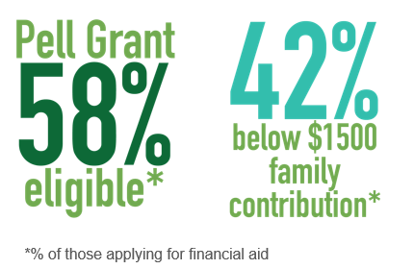
Our Undergraduate Students
Notes:
A closer look at our undergraduate students.
56 percent are first generation.
58 % are Pell grant eligible
37 % are from underrepresented populations
So when we look at all of this, we have an ethical imperative to focus not just on recruiting students but on ensuring the students we recruit graduate in a timely manner.

Slide 4

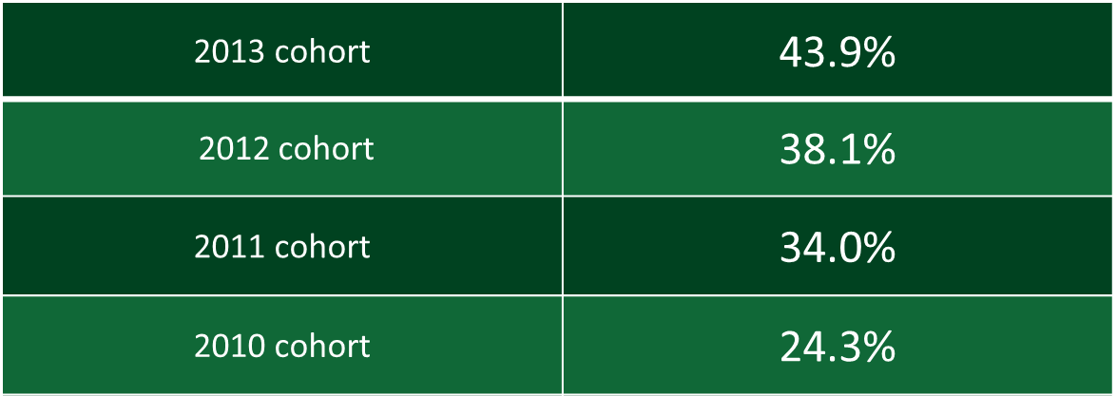
Increase 6-Year Graduation Rate
44.5%
Student
Success
Note:
National Rate 4-year public comprehensives 57.9 %
UW Rate 4-year comprehensives 55.0 %
Notes:
We're already seeing the positive results of our stratgies and tactics.
Our six-year graduation rate for the 2013 cohort is the highest in university historyNational graduation rate – 4 year public comprehensives 57.9%
UW 55.0

Slide 5
Disaggregated 6-Year Graduation Rate
 | PELL | White | AA | Hispanic
Cohort 2013 | 38.8 % | 49.0 % | 32.6 % | 26.4 %
Cohort 2012 | 30.9 % | 41.0 % | 22.0 % | 24.7 %
Cohort 2011 | 30.6 % | 37.0 % | 24.3 % | 30.8 %
Cohort 2010 | 24.0 % | 26.0 % | 11.0 % | 26.0 %
Student
Success
Notes:
While we have seen improvements and making big progress towards our BOLD goal, gaps by income and race/ethnicity still exist so the work continues.

Slide 6
Why is this important? Why now?
70 % or more of our courses will be online
Traditional approaches may be less effective
Prevent declines in credit accrual, retention and graduation
Financial stability
Notes:
Part of a UW System initiative
Math should align with your program of student
Way to get more students to take the math they need right away
Why? Student who complete their math course
Retained at a 30 % higher rate and are 6 x more likely to graduate in 4 years
There is asterick by education because if a students is doing secondary education, there pathway is determined by the licensure area. The other two astericks are because these programs are considering a shift but it will be for fall 2021.

Slide 7
Spring COVID Survey Results
78 % worried about doing well with their online classes
50 % worried about having the technology they needed
66 % worried about being able to pay their bills
41 % reported that their workload increased in the online environment
32 % said based on their experience they are less likely to take an online course
25 % said they did not know who to contact with questions or concerns and
almost 1/3 reported feeling little or no connection to UWP
Notes:
Part of a UW System initiative
Math should align with your program of student
Way to get more students to take the math they need right away
Why? Student who complete their math course
Retained at a 30 % higher rate and are 6 x more likely to graduate in 4 years
There is asterick by education because if a students is doing secondary education, there pathway is determined by the licensure area. The other two astericks are because these programs are considering a shift but it will be for fall 2021.

Slide 8

Our Approach
Use existing resources and Navigate to create a tiered approach to communication and support
2. Utilize our Navigate data and best practice research to
identify target populations for intentional outreach

Slide 9
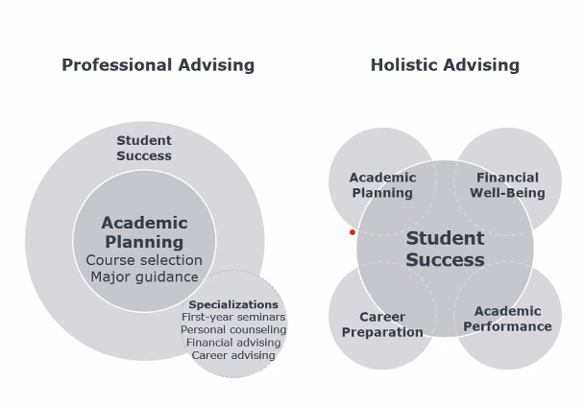

Slide 10
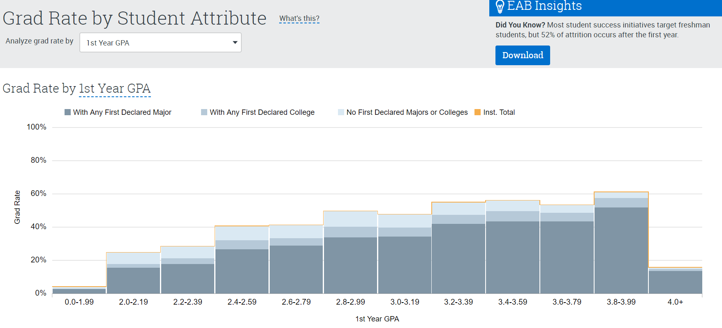
Navigate Analytics

Slide 11
Data informed approach
Academic risk – End of 1st year GPA between a 2.2 and 2.79 GPA, End of 2nd year GPA between 2.2 and 2.59
Financial risk – Pell eligible students
Enrollment pattern – Student enrolled in between 9 and 11 credits in their first term
Engagement risk – Undecided Freshman and new transfers or non-declared sophomores, juniors and seniors
Race/Ethnicity – Black students and Hispanic students

Slide 12
Tier One (All Students)
Current student website, Chat and Navigate Mobile app adoption
Canvas and Faculty – Resources, welcome videos, course outreach
Text message (e.g. Check in message –End of 1st wk)
Targeted emails (e.g. Tech Survey, appt campaigns)
To Dos (Key reminders throughout the semester)
Quick Poll (end of September and beginning of November)

Slide 13
Tier 2 (Target – Fresh/Soph)
Expand Advising care unit and implement additional touch points.
Utilize OMSA, SSS Peer mentors (Freshman URM/Pell eligible students) and Resident Advisor (non-Promise/SSS freshman in housing)
Expand Early alerts (Math and targeted courses in each meta major)
  Attendance/Engagement – wk 2
  Academic focus– wk 5
Identify targeted courses or programs (e.g. Promise / CNHS freshman seminars, theater and music, comm soph. seminar)

Slide 14
Tier 3 (Targeted)
Targeted Watch Lists (Navigate)
Voluntary Coaching
Academic Advisors and SSS
Und. new students
Soph/Jrs :2.2 - 2.79 GPA
Students with an early alert
OMSA Professional staff
Soph./Jrs 2.2 - 2.79 GPA, URM
Academic Advisors/SSS/OMSA)
Undecided sophomores
PARC academic coaches
Sophomores 2.2-2.5 GPA

Slide 15
Other Recommendations
Assign Pell eligible students a FA counselor contact
Expand technology support
Review collection practices
Notes:
ReUp - Stop Out Program
Software – Catalog, course and curriculum software
Freshman seminar and lower level HIPS (Gen education committee)
Emergency fund.

Slide 16
How will we measure success?
Credit accrual and retention rates are maintained particularly for black and Hispanic students
Withdrawal rates will be maintained or decreased
Students will report increased awareness of and use of support resources.
Navigate Reporting tools (e.g. app adoption, campaign responses, appointment summaries)

Slide 17
Questions???
Notes:
Earlier intervention/proactive advising
Peer and alumni mentoring
Math Pathways: major specific requirements
More engagement in high impact practices
Internships; work on campus
Community and business project experience
Access to international experiences
Opportunity to work with faculty

Slide 18


