Slide 1
Credit Momentum at UW-Parkside
UW System Advising Workshop
Pyle Center, UW-Madison
October 23rd
DeAnn Possehl, Assistant Provost for Student Success
Tammy McGuckin, Vice Provost, Student Affairs and Enrollment Services
Rob Ducoffe, Provost and Vice Chancellor, Academic and Student Affairs

Slide 2
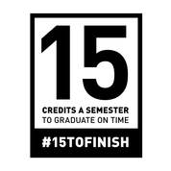
Outline
The case for credit momentum
What the data show at UW-Parkside
Messaging

Slide 3
The case for credit momentum

Slide 4
“The math is clear: in order to graduate on time, students must take at least 15 credits per semester or 30 credits per year….. Each extra semester comes with a cost, and the longer it takes, the more life gets in the way – decreasing the likelihood students will ever earn their degree. Further complicating the matter, federal financial aid policies require students to be enrolled in just 12 credits each semester to be eligible for assistance, creating a de facto standard that 12 credits is “full-time.” https://completecollege.org/strategy/15-to-finish/#overview

Slide 5
Percent of FT, FT students completing 30-credits in their first year
All Hispanic Black
Two-year 12% 8% 4%
Four-year all other 31% 25% 17%
Four-year highest research 45% 39% 31%
Source: https://completecollege.org/strategy/15-to-finish/#overview

Slide 6
Percent of students who earned a bachelor’s degree in 6-years: 1st –year credits
30+ credits 79.2%
24 – 29.9 credits 68.7%
12 – 23.9 credits 37.4%
0 – 11.9 credits 20.7%
Source: https://completecollege.org/wp-content/uploads/2017/11/CCA-Intensity-Brief-April3-1.pdf

Slide 7
2. What the UWP data shows

Slide 8
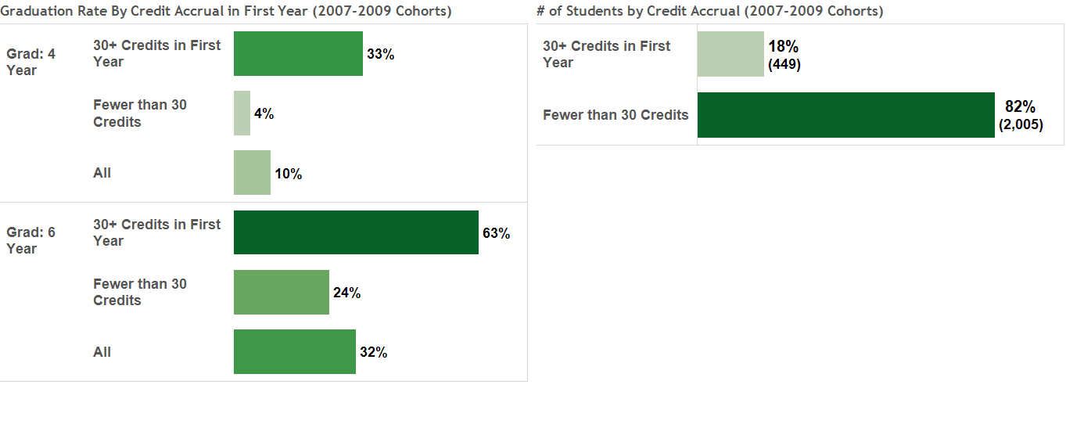
First Year Credit Accrual and Graduation Rates (2007-2009 Cohorts)

Slide 9
Average Credits Attempted and Passed in First Term by Intended College and Race (2007-2014 Cohorts)
Note: Includes first-time full-time students only

Slide 15
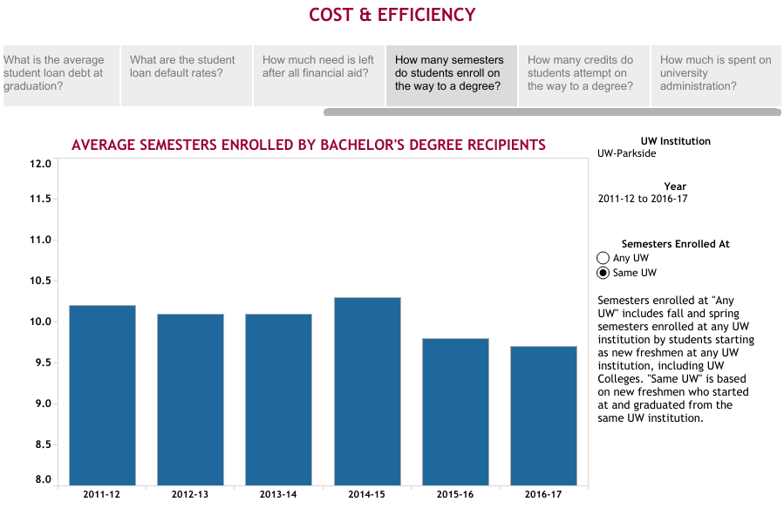

Slide 16
3. Our Messaging

Slide 17


Slide 18
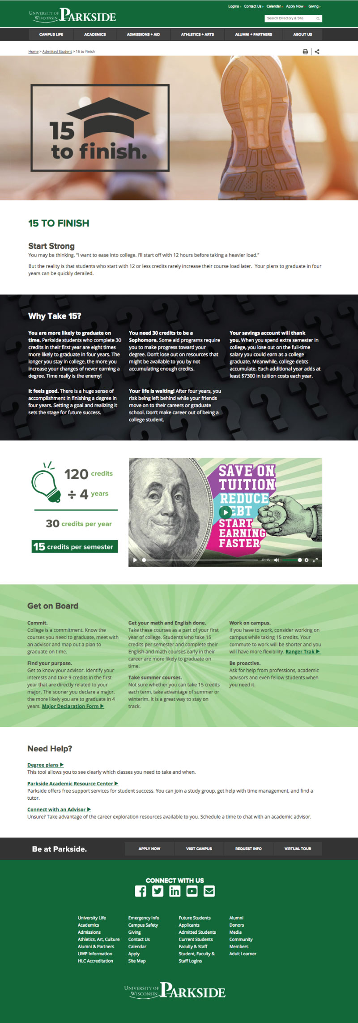



Slide 19
