Slide 1
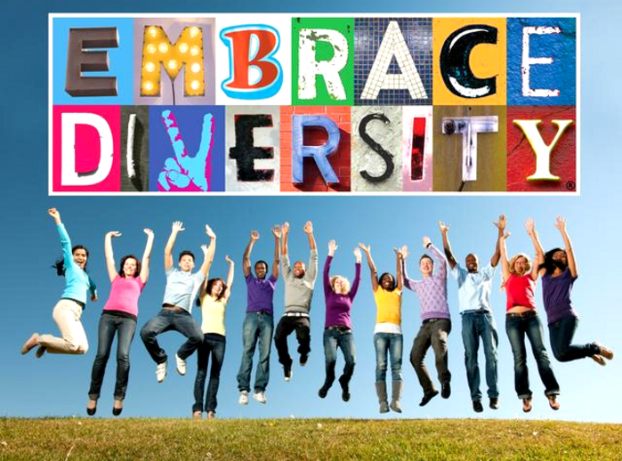
Your
Presented By
Dalinda Galaviz
Human Resources
Notes:
Why did you decide to sign up for this class and what are your expectations?
What are you expected to learn about yourself?
“When you are no longer afraid is when you can be yourself.” ― Shannon L. Alder
What I want to emphasize today in this training how you can incorporate your ideas and self into society and be respected and valued for your ideas? It’s not just embracing diversity (the concepts) is embracing YOUR diversity.

Slide 2
Coca-Cola Company
Diversity Message
https://youtu.be/wKCf-q0zqPs

Slide 3
Agenda
UW Parkside – Diversity Statement
What is Diversity?
What is Inclusion?
What is an Inclusive Environment?
Primary and Secondary Dimensions
Why does Diversity matter at a College?
How do we Embrace Your Diversity?
What is Culture?
Valuing Diversity?
What Level are You?
Notes:
Review the Agenda and if you have any questions, please feel free to ask at anytime during this presentation.
Next, it’s important we know the Diversity Statement as well as the Mission, Vision and Values of UW-Parkside.

Slide 4


Diversity
Vision, Mission and Values
Notes:
Know what the Diversity Vision, Mission and Values of UW Parkside … Read the next page

Slide 5
UW-Parkside
Diversity Statement
Diversity is crucial for maintaining excellence in research/creative artistry, learning and community engagement. The University of Wisconsin-Parkside celebrates many differences among people including but not limited to diversity in race, ethnicity, ability, national origin, gender, gender identity, sexual orientation, religion and age. UW-Parkside strives to strengthen diversity with programs that will accomplish the following:
attract and retain diverse students, faculty, and staff;
respect and appreciate the many cultures and multiple perspectives within the communities that UW-Parkside serves;
promote equity and success for all students, faculty and staff;
prepare students, faculty and staff to act ethically in relation to diversity on campus and in local and global communities
address racism, oppression, and all forms of neglect and discrimination throughout the campus at all levels.
Notes:
Read the Statement and then, ask the audience: How can we can better see each other as human beings and as well engage society in way we didn’t understand before so. We ask ourselves, how do we describe Diversity in our lives?
Diversity Statement
Diversity is crucial for maintaining excellence in research/creative artistry, learning and community engagement. The University of Wisconsin-Parkside celebrates many differences among people including but not limited to diversity in race, ethnicity, ability, national origin, gender, gender identity, sexual orientation, religion and age. UW-Parkside strives to strengthen diversity with programs that will accomplish the following:
attract and retain diverse students, faculty, and staff;
respect and appreciate the many cultures and multiple perspectives within the communities that UW-Parkside serves;
promote equity and success for all students, faculty and staff;
prepare students, faculty and staff to act ethically in relation to diversity on campus and in local and global communities
address racism, oppression, and all forms of neglect and discrimination throughout the campus at all levels.
Question to the Audience: What is Diversity? What comes in mind with you?

Slide 6
Vision
The Office of Diversity and Inclusion at the University of Wisconsin-Parkside will be recognized within the Great Lakes region as a premier office in fostering diversity and inclusion.
Mission
The Office of Diversity and Inclusion (formerly the Office of Equity and Diversity), established in 2011, collaborates with students, faculty, administrators, staff and members of the surrounding community to promote and implement the University of Wisconsin-Parkside's mission and strategic diversity and inclusion initiatives.
Values
Fair and ethical standards to all those we serve
Being good stewards of the resources we have
Quality programming as our way of operating
Being knowledgeable of emerging best practices and trends
The balance between professional and personal lives
The contribution of others that help achieve our goals and objectives
The ability to forge and develop collaborative and cooperative relationships with stakeholders
Having fun at work
Notes:
Vision
The Office of Diversity and Inclusion at the University of Wisconsin-Parkside will be recognized within the Great Lakes region as a premier office in fostering diversity and inclusion.
Mission
The Office of Diversity and Inclusion (formerly the Office of Equity and Diversity), established in 2011, collaborates with students, faculty, administrators, staff and members of the surrounding community to promote and implement the University of Wisconsin-Parkside's mission and strategic diversity and inclusion initiatives.
Values
Fair and ethical standards to all those we serve
Being good stewards of the resources we have
Quality programming as our way of operating
Being knowledgeable of emerging best practices and trends
The balance between professional and personal lives
The contribution of others that help achieve our goals and objectives
The ability to forge and develop collaborative and cooperative relationships with stakeholders
Having fun at work

Slide 7
What is Diversity?
Diversity encompasses all those differences that make us unique, including but not limited to race, color, ethnicity, language, nationality, sexual orientation, religion, gender, socio-economic status, age and physical and mental ability.
Notes:
What is Diversity? What comes in mind with you? If you are most people, we think of race, ethnicity, religion, country of origin, language, gender, sexual orientation, socioeconomic status. What people or companies tend to do to implement diversity they only see and looking for the race, ethnicity, sexual orientation which all are good things, but we miss something that is so fundamental and that is Diversity as simplest form and not just race, sexuality, gender religion, …. It is DIVERSITY is simply DIFFERENCE.
A lot of people have Good head knowledge of diversity and don’t have the heart knowledge of diversity.
The heart is where it really changes … My intent today is to move our thinking from head to heart.
How many do we know someone that because of a statistic, they changed their views on something because of a finding… “Now I am going to change because in Time’s Magazine blah, blah, blah …”
But when we hear stories and engage with real live people we understand better about each other and we begin to embrace everyday differences.
When we move from head to heart it really challenges us to approach diversity in a different way.

Slide 8
What is Inclusion?
the thread that holds us together
Inclusion involves bringing together and harnessing diverse forces and resources in a way that is beneficial. Inclusion puts the concept and practice of diversity into action by creating an environment of involvement, respect, and connection—where the richness of ideas, backgrounds, and perspectives are harnessed to create business value and overall success.
Notes:
So here is the definition of inclusion in the sense of diversity … read the statement above …
So, what is the big deal about inclusion? It is easy to include others. All you have to do is make sure you actually notice people, smile at them, acknowledge them, say hello, make them feel good about themselves, include them in your conversation, seek their opinions, reassure them that you like them, actively demonstrate you are listening to them, help them to feel validated, and reassure them that their ideas have value … hmmm!
OK, so let’s admit it; being human really means that being inclusive has caveats. It is easy to be inclusive if I like you; it is easy to be inclusive if I agree with you, or more important, if you agree with me; it is easy to be inclusive if I have some affinity with you; it is also easy to be inclusive if I need something from you or if you need something from me that I am willing to share.
See? This is getting messy and we haven’t even scratched the surface. As well-intentioned people, we all want to believe that we are inclusive of others and that we would conceptually support the idea of becoming more inclusive.

Slide 9
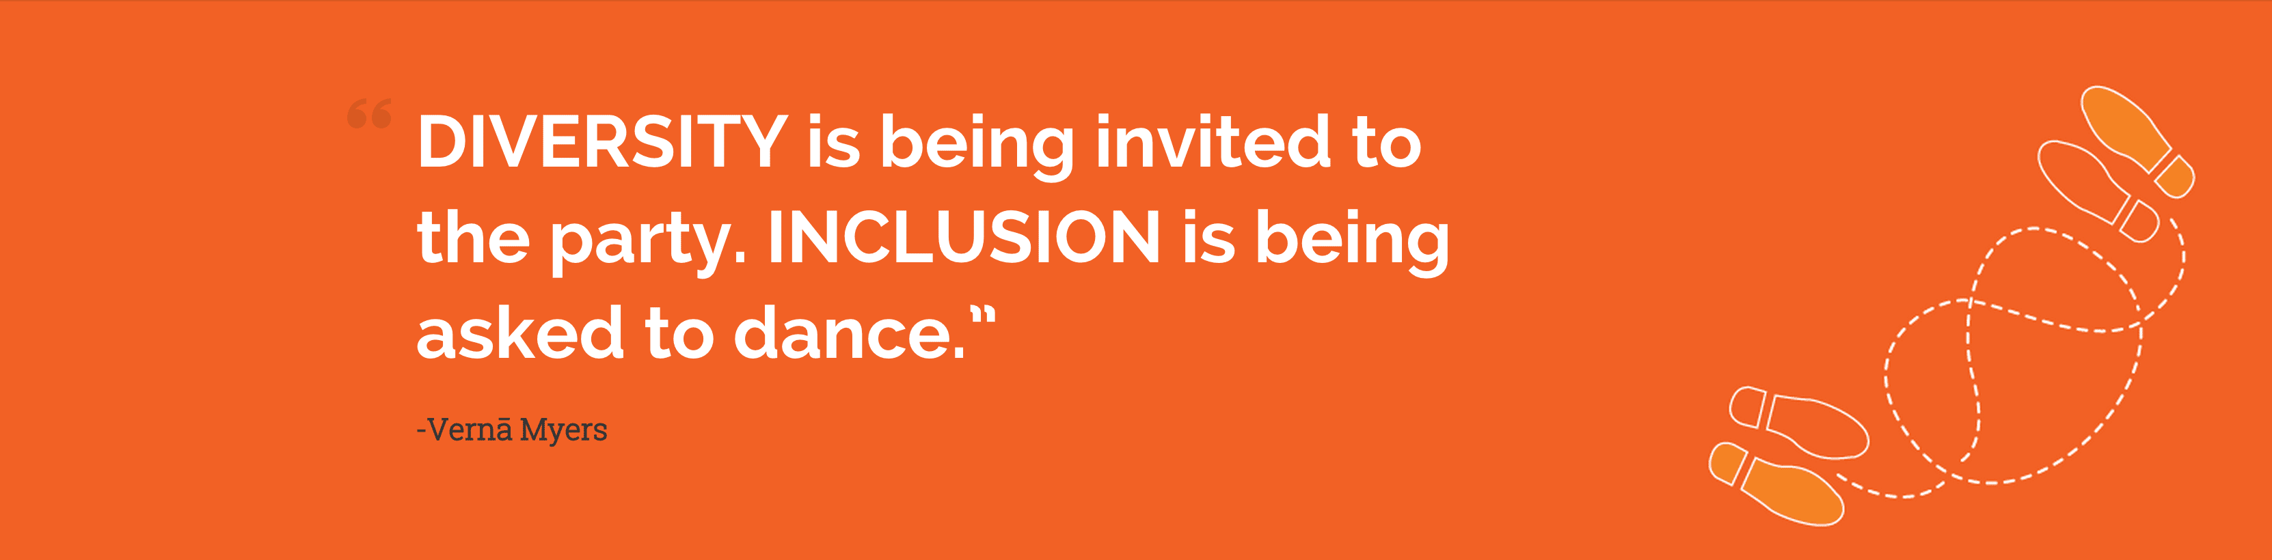
Notes:
This is what sums up Diversity …

Slide 10
What is the difference between Diversity & Inclusion?
Diversity is simply a representation of many different types of people (gender, race, ability, religion, etc.)
Diversity often focuses on the differences, and is referred to as "the mix.“
Inclusion is the deliberate act of welcoming diversity and creating an environment where all different kinds of people can thrive and succeed.
Inclusion is the act of "making the mix work."
Diversity is what you have. Inclusion is what you do.
Simply having a diverse group, team, workforce, classroom, etc., is not enough.
Everyone should feel safe and encouraged to fully participate and share and be on equal footing as everyone else.
Notes:
Read the slide then … read below …
Diversity and Inclusion The words “Diversity” and “Inclusion” are often used in the same sentence as if they are inseparably linked, but, in fact, diversity is the mix and inclusion is the effort that it takes to make the mix work.

Slide 11

The Mix
Notes:
Diversity is the mix. Inclusion is making the mix work.
If you look at this picture, what do you see?
So you have a few ingredients, boring … but when you put them all together … what do you get? Likewise, having a diverse workforce does not guarantee that you understand how to make that mix work or how to unlock its full potential.
Creating an inclusive environment is complex. It requires effort and that we first unpack the complexity before we can begin.

Slide 12
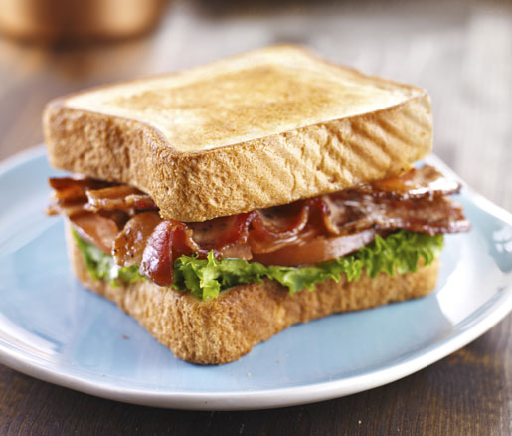
The Mix
Bacon, Lettuce & Tomato Sandwich
Inclusion is . . . “Making the Mix Work”
Notes:
A Bacon, Lettuce & Tomato Sandwich
Let’s return to my sandwich. If I hand you a two pieces of bread, bacon, lettuce, tomato and mayonnaise (or in my case Miracle Whip) you may intuitively figure out it was a bacon, lettuce and tomato sandwich. On the other hand, they may stay in your mind as separate and disparate objects with no vision that a sandwich is possible. If I hand you an avocado, grilled chicken I suspect it would not be so intuitively obvious that you could make a bacon and chicken sandwich. If I then added several slices of jalapenos, sweet and spicy sauce, my guess is that you would look at me strange, and would never be able to imagine that these ingredients would make a divine Sweet and Spicy BLT Club
These alternative recipes offer new and exciting possibilities for creativity, but only if we are open to allowing differences to flourish. What are we missing when we maintain the status quo…when we remain stuck in old paradigms…when we operate from a mode of assimilation…when we allow our blind spots and unconscious biases to block our vision of a more inclusive organization?

Slide 13
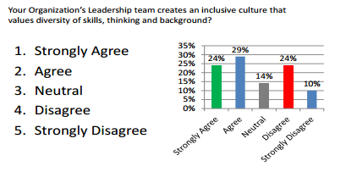
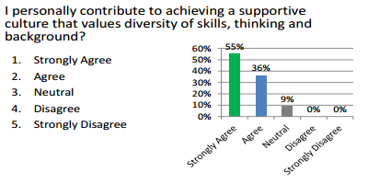
What is an Inclusive Environment?
Study by
Dr. Helen Turnbull, CEO Human Facets
Notes:
A study by Dr. Helen Turnbull, CEO of Human Facets LLC states the following. Her findings were the following working in the field of global inclusion, diversity, and unconscious bias, she noticed an interesting phenomenon. When she asked people if their leaders contribute to creating an inclusive environment, the results typically look like this … review the charts …
It seems that we all think we are doing better than everyone else at being inclusive. That is our first blind spot. If we believe it is other people and not us, we will always be waiting for others to see the light, while not seeing the impact of our own unconscious biases and shortcomings. Controlling our ego needs, admitting our resistance to change, and managing our own blind spots are all part of the journey. There is no exception; we all have a piece of the story.

Slide 14
An Exercise
How inclusive are you really?
How do your personal biases impact your ability to be inclusive?
How do your blind spots impact the quality of your day-to-day decisions?
How do you know that you are really being objective?
Who is in your In-Group?
Who do you not notice at work?
How do you know when someone is a “good fit”?
What criteria are you using?
Notes:
ASK THE AUDIENCE: We all have a piece of the story. So let me leave you with a few questions to ask yourself. Exercise for groups of 3.
• How inclusive are you really? • How do your personal biases impact your ability to be inclusive? • How do your blind spots impact the quality of your day-to-day decisions? • How do you know that you are really being objective? • Who is in your In-Group? • Who do you not notice at work? • How do you know when someone is a “good fit”? • What criteria are you using?

Slide 15
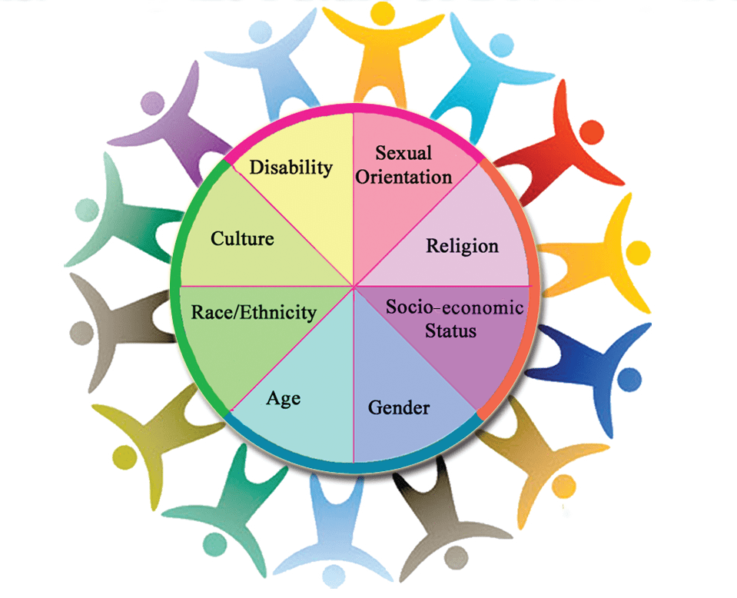

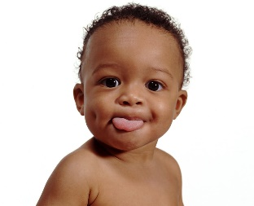
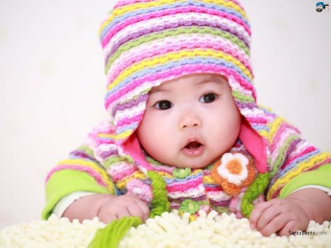
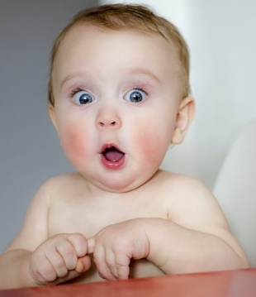
Primary Dimensions
It’s what we are born with is our identity.

Slide 16
Secondary Dimensions of Diversity
The
Value
System
Family
School
Neighborhood
Friends
Prejudices
Media
TV
Internet
Music
Religion
Church
Secondary Dimensions
These dimensions change throughout our lives.

Slide 17
Why does Diversity matter in a
College environment?
Interaction with people from diverse groups.
Diverse workforce with different cultural backgrounds.
Work with employers, employees, coworkers, and customers from diverse backgrounds—worldwide.
Increase our knowledge base.
Promotes creative thinking
Enhances self awareness
Enriches multiple perspectives
Notes:
College atmosphere provides the opportunity to have real interaction with people from diverse groups.
You will find a diverse workforce with different cultural backgrounds.
No matter what profession you are in, you'll find yourself working with employers, employees, coworkers, and customers from diverse backgrounds—worldwide.
Interactions with people different from ourselves increase our knowledge base.
Diversity promotes creative thinking. Diversity expands your capacity for viewing issues or problems from multiple perspectives, angles, and vantage points.
Diversity enhances self-awareness. Learning from people whose backgrounds and experiences differ from your own sharpens your self-knowledge and self-insight by allowing you to compare and contrast your life experiences with others whose life experiences differ sharply from your own.
Diversity enriches the multiple perspectives

Slide 18
How To Embrace Your Diversity?
Everyone’s Narrative
Where are you coming from?
Befriend All People
Empathy
Actively Accept
Show Compassion
Notes:
Everyone’s Narrative - Consider your own life, and everything that has shaped your beliefs. Realize that each of the 7 billion people on this planet has their own narrative. Not one is the same.
Where are you coming from? - When you find yourself thinking poorly of someone, stop and consider what influences have created your negative views of that individual.
Befriend all people – If you know that you tend to avoid befriending certain types of people, go out of your way to find friends of all kinds.
Empathy – When you encounter anyone, try to imagine, understand, and sympathize with that person’s story, with everything that has made them who they are.
Actively accept – meditate upon embracing other people, with all of the diversity that comes with them. Don’t allow yourself to define a person based upon one stereotype about one aspect of their complex identity.
Show compassion - Perform random acts of kindness for all types of people. It can be as simple as a friendly smile or holding open a door.
*** Practice EMPATHY, don’t be quick to judge, and envision life in another’s person’s shoes before you treat them unfairly.

Slide 19
Accenture
“Inclusion Starts with I”
https://youtu.be/2g88Ju6nkcg
I

Slide 20
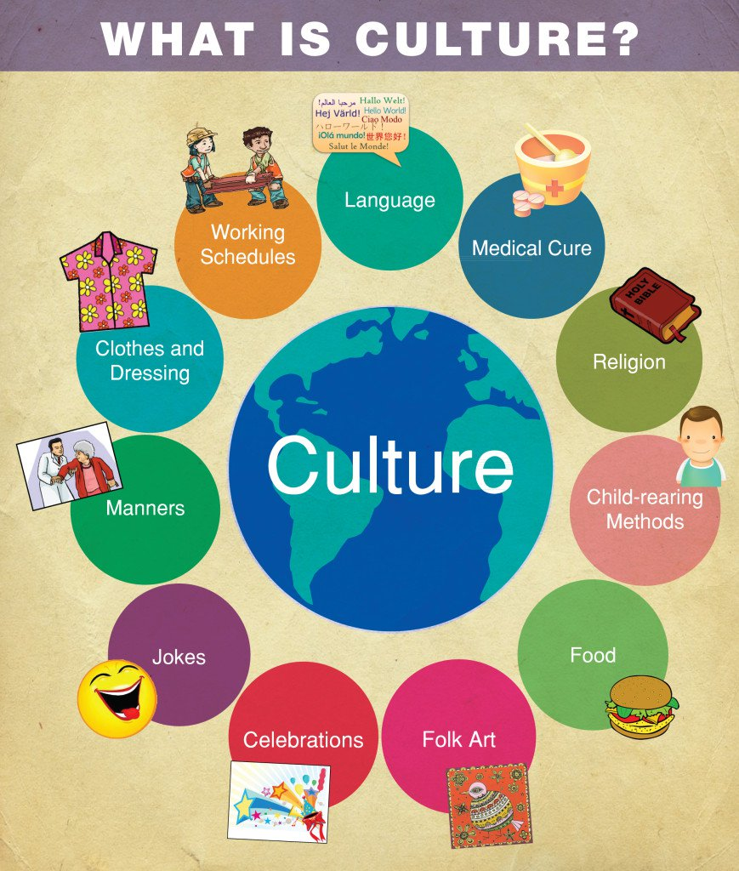
What is culture, and why is it important?
What is cultural awareness, and why is it important?
How can we achieve and assess cultural awareness?
Notes:
Now we are introducing another element of diversity which is Culture.

Slide 21
Definition of Culture?
Patterns of human behavior common to groups
Includes thoughts, communications, languages, practices, beliefs, values, customs, courtesies, rituals, manners of interacting, roles, actions, relationships, and institutions
Groups are based on race, ethnicity, gender, religion, sexual orientation, social group or other similar factors
With the ability to transmit the above to succeeding generations.

Slide 22
Cultural Diversity in the Workplace
Cultural diversity in the workplace provides strength. It also challenges individuals to respond to their diverse work environment effectively.
“Valuing” individual and group cultural differences is critical to achieving the organizational goals.

Slide 23
Cultural Awareness
Know your own cultural background.
Recognize your own stereotypes and biases.
Gain knowledge of cultural history and heritage.
Be aware of other’s perceptions.
Recognize effects of -ism on the others.

Slide 24
Embrace Discomfort
The point is to surround ourselves with people who think and act differently than we do.
The business value of diversity lies in having our views challenged.
Notes:
Now here is the challenge …
In order to embrace diversity and encompass our own diversity, you can start by surrounding yourselves with people who aren’t like us. We try constantly to be in the same room with people who challenge not only our day to day thinking but the way we view the world.
We put the right people in places and expect them to challenge our dearly held beliefs. This gets uncomfortable at times. But we’re not going to generate new ideas with homogenous thinking.

Slide 25
Fixed vs Growth Mindset
I used to . . .
Think
But now I . . .
Think
Feel
Feel
Act
Act
The results of my changes are . . . How will this change me moving forward?
Notes:
This is also a way for us to start thinking and not get stuck in the past … because we will not survive in our melting pot of a country.

Slide 26
Key Concepts to Remember
You will offend someone at some point.
Each person has a right to their own opinion.
Listen. We all have a unique world-view.
What is each person’s lens of diversity?
“Tell me more …”
“I wonder if ... “
We must allow ourselves to be vulnerable when talking about diversity.
Promotes a safe and accepting environment
Leads to guided self-regulation and learning
Notes:
How are we open to learning and change? This is a dynamic, life long process!
Avoid judgements.
Being vulnerable when talking about diversity results in open and honest communication. (Yes, this is hard!)

Slide 27
What does it mean to be Authentic:
to be more concerned with truth than opinions
to be sincere and not pretend
to be free from hypocrisy: “walk your talk”
to know who you are and to be that person
to not free others seeing your vulnerabilities
being confident to walk away from situations where you can’t be yourself
be awake to your own feelings
being free from others’ opinions of you
accepting and loving yourself
Sue Fitzmaurice
Notes:
What is really important is being Authentic … which means the following. If you don’t people will see it and don’t want to be around you.
Now how can we start this process …

Slide 28
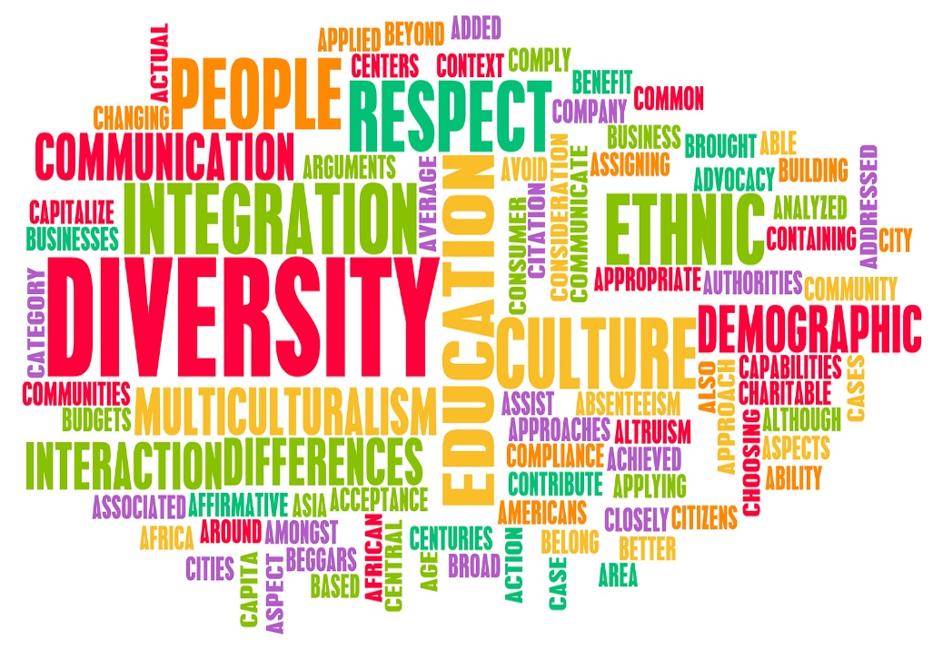
Create an environment of specific Wordle or a general one showing the different kinds of diversity
Notes:
Start with this and embrace this concept … by putting words around you to remind you and create the environment for others to see. Actions also speak louder than words. This was illustrated before the study Dr. Helen Turnbull, CEO Human Facets conducted and demonstrated how they perceived diversity and yet it didn’t reflect on how employees saw their own ability to embrace diversity.

Slide 29
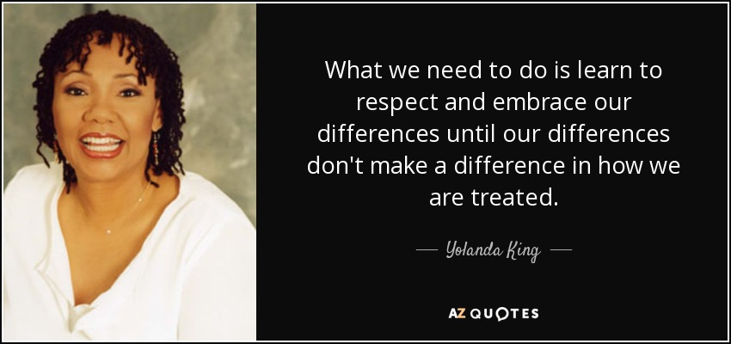
Notes:
Here is another quote from Yolanda King on respect and embracing differences … read

Slide 30
Valuing Diversity
Embraces the richness of differences
Recognizes that all groups have contributed and has given American society its strength and edge.

Slide 31
Resistance to Valuing Differences
Fear of Change
Lack of information and limited exposure to members of other groups
Discomfort with Differences
Desire for return to the “good old days”
Notes:
Why do people resist differences … This is common but I challenge each one of you to take that step and learn about others, ask, make a new friend … you will not regret!

Slide 32

What Level do you Value Differences?
Value
Accept
Celebrate
Tolerate

Slide 33
Tolerate
To endure or put up with someone’s differences
(As a Culture we tend to be)

Slide 34
Accept
Content with Someone’s Differences

Slide 35
Value
To be Open and See someone’s differences as Worthwhile

Slide 36

To deeply understand and respect each others view point openly

Slide 37
Where are YOU Now?

Slide 38
TV2 Danmark
“All That We Share”
https://youtu.be/jD8tjhVO1Tc
Notes:
This wraps up how we are not as different as you think …

Slide 39

Thank You!

