Slide 1
Worker’s Compensation
Supervisor Training
Presented By
Chris Heilgeist
HR Assistant/WC Coordinator
Human Resources
Bob Grieshaber
Risk Management Officer
Safety & Risk Management
Notes:
Speaker Notes:
Welcome to Worker’s Compensation for Supervisors training.
If you’re not a supervisor but have a lead role or an admin role in your department, you’re not at the wrong training.
Sometimes a supervisor isn’t around/available when a work injury/illness occurs and so you may need to step in and assist. Welcome!
My name is Chris Heilgeist. Among other things, I am the WC Coordinator for Parkside. My co-presenter today is Bob Grieshaber, our Risk Management Officer.
Before we get started – a few housekeeping items
If you haven’t signed in, please do so (back of the room); we’ll be sending an email following this session with answers to questions that were asked and some ideas about next steps
You received the PowerPoint yesterday as well as a workflow handout by email yesterday.
We also plan to post these presentations on the HR Training website page once we’ve completed this round of Lunch & Learn sessions
For purposes of confidentiality, please do not share employee specifics during today’s session. Should you wish to discuss a specific employee in detail, please stay after the session and we can schedule a meeting date/time.
So Bob and I can get a better sense of your experience with Worker’s Compensation and your expectations of today’s session, please…
Introduce yourself,
Tell us how many work related injuries/illnesses you’ve dealt with (none, 1, multiple), and
What you’d like answered in today’s session.
Thanks for sharing.
Introduce HPDL concept
Flipchart page will capture questions we can’t answer or items that need to be addressed but perhaps not in this session.
Provide context regarding WC and Safety
Throughout today’s session, we’ll ask you to think about oppty to build/reinforce safety culture
We’ll capture those ideas on the flipchart and send the list from both HPDL and Safety out to you following this training.
Bob can you talk a bit about the components of an effective safety culture and what authorizes employers to maintain a safe work environment?

Slide 2
Authority for Health & Safety
Under state law, employers have a duty to provide safe employment, which includes having a safe place to work and free of recognized hazards. UW System institutions are responsible for the maintenance of environmental, occupational health and safety standards and for the promotion of workplace health and safety and environmental quality.
OSHA Regulations: 29 CFR 1910 and 1926
Wisconsin State Statutes
University of Wisconsin System Policies
State of Wisconsin Executive Orders
Campus and UW Policies, Practices and Guidelines
Notes:
Speaker Notes:
Why do we do this safety stuff?
Discuss some of the laws and regulations, including the OSHA general duty clause, which is a workplace free of recognized hazards.
Under the Resources section of this presentation, you will find hyperlinks to these laws, regulations, executive orders, policies and practices.

Slide 3
Components of a Safety Culture
Communicate campus and departmental values
Demonstrate leadership at all levels, safety coaching concept
Clarify required and expected behavior
Personalize safety outcomes
Develop positive safety attitudes including open dialogue
Engage and own safety responsibilities and accountabilities
Increase hazard & risk awareness, and preventive behaviors
Improve understanding and effective implementation of safety and risk management systems
Use positive reinforcement
Monitor, review and reflect on personal and organizational effectiveness
Adequate funding, support and professional development
Source: Workplace Health and Safety Queensland, and Robert Grieshaber
Notes:
Speaker’s Notes:
According to OSHA, developing a strong safety culture has the single greatest impact on accident reduction of any process.

Slide 4
Benefits of a Safety Culture
Reduced incidents/injuries
Increased productivity
Reduced costs
Reduced turnover
Notes:
Speaker’s Notes:
According to OSHA, developing a strong safety culture has the single greatest impact on accident reduction of any process.

Slide 5
Cost of Worker’s Compensation
Lost time
Medical reimbursement
Reduced productivity
Turnover
Notes:
Speaker’s Notes:
Lost Time
60 “away from work” days in 2017
231 “restricted duty” days in 2017
Cost of Lost Time and Medical Reimbursement each year determines whether the $$’s we set aside for Worker’s Compensation increase or decrease year to year.
Before we leave the topic of safety culture, what one thing could you plan to do in your area to reinforce safety for your team? (bulletin board, provide safety training upon hire and regularly thereafter, catch someone doing something right, share lessons learned after an incident, take action when safety procedures aren’t followed or PPEs aren’t used, other?)

Slide 6
Course Objectives
Worker’s Compensation basics
Supervisor’s role
Employee’s role
Resources
Notes:
Speaker’s Notes:
When you leave today, you will understand:
Add one more to the objectives: that each of you will have selected one or more steps you can take tomorrow, next week or this month to build or reinforce the culture of safety on your team.

Slide 7
Basics
Worker’s Compensation

Slide 8
Worker’s Compensation Basics
Definition
Benefit program
Loss of wages
Medical and hospital expenses
Restore work capacity
Covers work-related injuries or illnesses
Eligibility
Employee of University of Wisconsin-Parkside
Work-related injury/illness
Notes:
Speaker’s Notes:
Often referred to as the “grand bargain” between employers and employees, this program was established over 100 years ago. In 1911, WI adopted Workmen’s Compensation Act – one of the first states to do so.
Injured/ill workers gave up their right to sue employers in civil court for workplace injuries. ERs were able to rely on WC as the exclusive remedy for such injuries in a no-fault system. Not always an exclusive remedy and not always a no-fault system.
Employee - includes student employees. Does not include volunteers or general public.
Work-related injury/illness – this is determined by UW System claims examiners.

Slide 9
Roles and Responsibilities
Worker’s Compensation
Notes:
Speaker Notes:
Now that you understand the basics of WC, what it is, what benefits it provides, and who is eligible,
let’s focus on the various roles and their responsibilities in the Worker’s Comp process.

Slide 10
Worker’s Compensation Roles
Employee
Supervisor
HR Coordinator
UW System Claims Examiner
Safety & Risk Manager
Notes:
Speaker’s Notes:
These 5 roles are the primary roles, but recognize there are additional roles beyond these 5: medical providers, lead employees or admin’s who may stand in for supervisor if not present, other employees who might witness the incident who you might want to interview, etc. We’ve identified the 5 primary roles.
Although you’ll find 5 roles in this graphic, we will be focusing on your role as a supervisor and the employee’s role in worker’s compensation claims.

Slide 11
Employees’ Role
Time Sensitive Tasks
Report Incident
Seek medical attention if needed
Complete Form(s)
Notes:
Speaker’s Notes:
URGENT TASKS
Timely reporting – (verbal) immediately or ASAP
Who to notify if you aren’t available
Who to notify if off hours
Seek Medical attention if needed
You may need to play a role if employee unwilling or unable to make this determination. You can also involve Police and HR. We’ll discuss in upcoming supervisor slides.
Complete and submit forms ASAP (within 24 hours) – compliance issues with late reporting

Slide 12
Employees’ Role
Ongoing Tasks
Communicate with HR/Supervisor
Share WC contact information with Provider
Accept restricted duty/honor restrictions
Report Time/Absences
Notes:
Speaker’s Notes:
Ongoing responsibilities are covered with employee either at in person meeting or by phone. Follow up email is sent once claim is opened or earlier if documentation is missing and includes an attachment with their WC responsibilities. (One of the handouts we’ve provided for your info)
Communicate:
Follow “call in” procedures and other work rules
Provide HR w/timely Work Status Reports/cannot return until we receive this if they have “lost time” due to claim
Share WC contact info – important that HR and EE meet or talk (cover basics of program, their responsibilities, etc.)
Restricted Duty
We have at least 24 hours to review restrictions
Should employee refuse restricted duty in whole or in part; they will lose part/all of their lost time reimbursement
Absence reporting
EE can elect which “leave take” to use or record LWOP if no balances available; Supv has ability to influence this as well if your work rules cover this
If LWOP for lost time that is reimbursable, EE will have deductions taken for WRS payback
Enter absences or work with HR so they can enter absences for consecutive lost time absences

Slide 13
Supervisor’s Role
Time Sensitive Tasks
Assist Employee
Notify HR & Safety & Risk Mgr
Investigate
Complete/submit forms
Notes:
Speaker’s Notes:
URGENT TASKS
Assist EE
Get them the form and help them complete the EE Illness/Injury Report
What if you aren’t there? Who else knows where to find form/how to complete form?
If EE doesn’t feel able to complete the form but is able to answer questions, assist them in completing the form and simply have them sign the form when completed. You can add a note to the form that you assisted them by documenting their answers
Medical Treatment determination may play a role in how/when form is completed
Seeking medical attention – if they are unable to drive themselves, arrange to contact emergency contact, relative or friend; Call 2911 if unconscious, seriously injured or ill; police will call ambulance if needed
Signs that medical attention may be needed:
EE suggests it
Emergency situation – loss of consciousness, severe injury
Bleeding
Pain, Numbness
Confused aspect or dizziness
EE – for non-emergency situations, EE can elect whom to seek treatment with. We counsel EEs to stay within their current health care coverage in case claim is denied so they limit their financial exposure
Notify HR & Risk Mgmt
How to handle if off hours? Email/phone message
Investigate
If there is an injury which requires medical attention or lost time due to injury/illness, Bob Grieshaber should complete the investigation with you or in addition to your own investigation
Purpose is to gather clear and complete details for your Accident Analysis report but also to determine how incident could have been avoided (change in process, use of PPE, following safety procedures, slowing down, paying attention, etc.)
Complete as soon as possible given that we would like the forms returned to HR within 24 hours
How could investigation results assist in reinforcing culture of safety? Follow up could include – conversation with employee, retraining, review of PPE policy, lessons learned for entire team, disciplinary action in select cases, etc.)
Complete/submit forms
ASAP – within 24 hours if possible
What if you aren’t in office? Who is backup?
What do leads and admin’s understand about this process?

Slide 14
Incident Categories:
The causes of any incident can be grouped into five categories, and each should be investigated.
INVESTIGATE
Source: Canadian Centre for Occupational Health & Safety
Notes:
Speaker Notes:

Slide 15
INVESTIGATE
Ask
Who
What
When
Why
Where
How
PPE
Emphasis to find the root cause
Prevent future incidents (i.e., how can this be avoided in the future?)
Find the facts that lead to corrective action
Reinforce positive behavior & expected behavior
Reduce lost time
Emphasis on early return to work
Notes:
Speaker Notes:
How do you get at root cause? By asking questions to unpack the incident.
How do you reinforce safety culture? By asking how it could be prevented in future.
What did the employee do right during the incident?
What behaviors did you expect that the EE didn’t perform? Share this feedback and coach for improvement.
PPE? Was it issued? Is it required for the task being performed? Did EE use it?

Slide 16
Supervisor’s Role
Ongoing Tasks
Communicate with HR/Employee
Coordinate Return to Work
Review/Approve Time/Absences
Maintain confidentiality
Maintain a culture of safety
Notes:
Speaker’s Notes:
ONGOING TASKS
Communicate
EE – if employee suffers lost time due to illness/injury, calling or sending a card to let them know you’re concerned about them is helpful; do not request medical details and do not share medical details with others (if EE shares with you)
HR - If EE attempts to return without submitting a Work Status Report to HR; we have 24 hours at a minimum to review and respond to restrictions or full duty return
HR – regarding work restrictions, schedule, changes or issues with restricted duty
Coordinate return to work
Work with your supervisor, Grieshaber and HR to determine what duties you can offer that meet restrictions; consider their current PD when doing so
Contact EE with details: where/when to report, what duties they will perform, schedule; follow up with employee through initial days to make sure they are following restrictions; if paired with another EE, check in with buddy to verify restrictions are being followed; objective is to keep them productive while avoiding risk of reinjury.
HR will prepare a Return to Work Agreement which both you and the EE must sign/date and return to HR
T&L
Review and approve absence requests; approvals only needed if EE is entering absence requests
Keep watch on balances to make sure EE is not overusing time
Safety Culture
Come up with ways to incorporate safety into daily/weekly meetings, new hire orientation, etc.

Slide 17
Resources
Worker’s Compensation
Notes:
Speaker Notes
We’ve covered a lot of material so far. Please don’t think that you have to remember everything. To help you when worker’s compensation incidents arise, we and UW System ORM have provided materials you can reference.

Slide 18
Resources
Safety & Risk Manager Bob Grieshaber Ext. 2262
WC Coordinator Chris Heilgeist Ext. 2220
Campus Police Non-emergency – ext. 2455 Emergency – ext. 2911
Others?
People
Notes:
Speaker’s Notes:
PEOPLE RESOURCES
Bob is your resource for questions about safety, personal protective equipment, investigation of incidents, safety training, consult on restricted duty, etc.
I am your HR contact for reporting, forms, absence entry/approval, applicability of FMLA leave, Return to Work Agreements
Campus Police is your resource if the incident occurs between 4:30 p.m. and the following morning 7:45 a.m. AND/OR if the injury is serious enough that the employee’s injury or unconsciousness suggests the need for assistance in transport.
Others? Think about a scenario where an incident occurs when you aren’t on campus (vacation, sick day, different shift). How would you like the injured employee and any co-worker witnesses to respond? Do they know this?

Slide 19
Resources
Forms
Roles/Responsibilities
UW System Office of Risk Management
Electronic
Notes:
Speaker’s Notes:
All of the materials mentioned here are available electronically through HR’s website. Even the UW System materials can be accessed by navigating to the HR web pages.
Let’s do that. Once you navigate to our site, you will find that it is organized to make your search quick and easy.

Slide 20
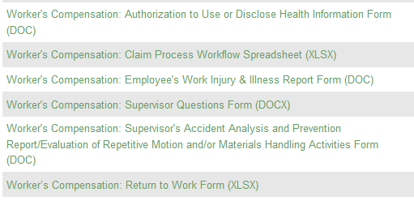
Resources -Forms
https://www.uwp.edu/explore/offices/humanresources/all-forms.cfm
Notes:
Speaker’s Notes:
Two different locations for Worker’s Compensation forms
Both through the HR website
First is under forms – scroll to bottom

Slide 21
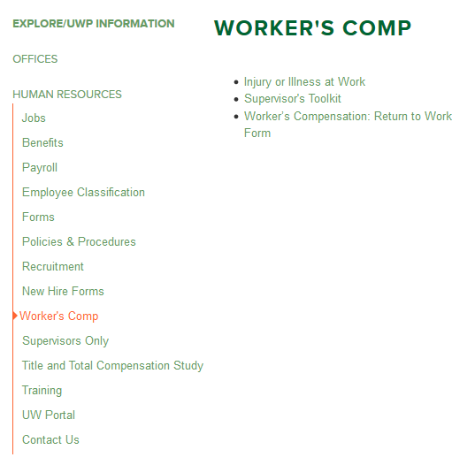
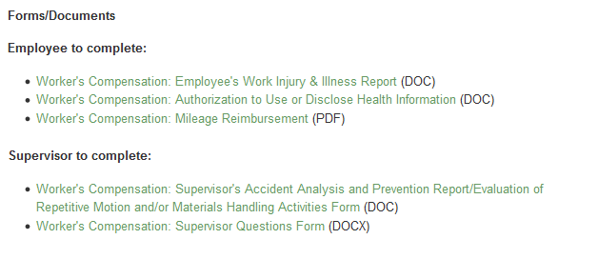
Resources - Forms
https://www.uwp.edu/explore/offices/humanresources/workers-comp.cfm
Notes:
Speaker’s Notes:
Second location is under Worker’s Comp/Supervisor’s Toolkit

Slide 22
Resources
Roles & Responsibilities
https://www.uwp.edu/explore/offices/humanresources/illness.cfm
Notes:
Speaker’s Notes:
I borrowed a workflow chart from another UW campus and edited for our purposes
This covers basic responsibilities across the various WC roles
You received this in a link on my earlier email with this PowerPoint presentation
You can access this electronically under Worker’s Comp/Injury or Illness at Work

Slide 23
Resources
UW System ORM Worker’s Compensation Site
https://www.wisconsin.edu/workers-compensation/
Notes:
Speaker’s Notes:
Also UW System Office of Risk Management has a great Worker’s Compensation website with additional information and resources.
You can use the link in the presentation or you can find this under Worker’s Compensation/Supervisor Toolkit under Related Links

Slide 24
Resources
Laws, Regulations, Policy and Practices
OSHA 29 CFR 1910 and 1926
https://www.osha.gov/
Wisconsin Statutes §101.055 Public Employee Safety and Health
http://docs.legis.wisconsin.gov/statutes/statutes/101/I/055
Wisconsin Statutes §101.11 Employer's duty to furnish safe employment and place
http://docs.legis.wisconsin.gov/statutes/statutes/101/I/11
University of Wisconsin System UPS Operational Policy: GEN 11
https://www.wisconsin.edu/ohrwd/download/policies/ops/gen11.pdf
State of Wisconsin Executive Order 194 for workplace safety (July 1993) https://walker.wi.gov/sites/default/files/executive-orders/EO_2016_194.pdf
Campus and UW Policies, Practices and Guidelines https://www.uwp.edu/explore/offices/governance/policy67.cfm https://www.uwp.edu/explore/offices/humanresources/illness.cfm
.
Notes:
Speaker Notes:
For additional reading about the laws, regulations, policies and practices that underpin an employer’s duty to provide a safe environment for employees.

Slide 25
Exercises and Scenarios
Worker’s Compensation
Notes:
Now let’s apply some of the Worker’s Comp information we’ve reviewed.

Slide 26
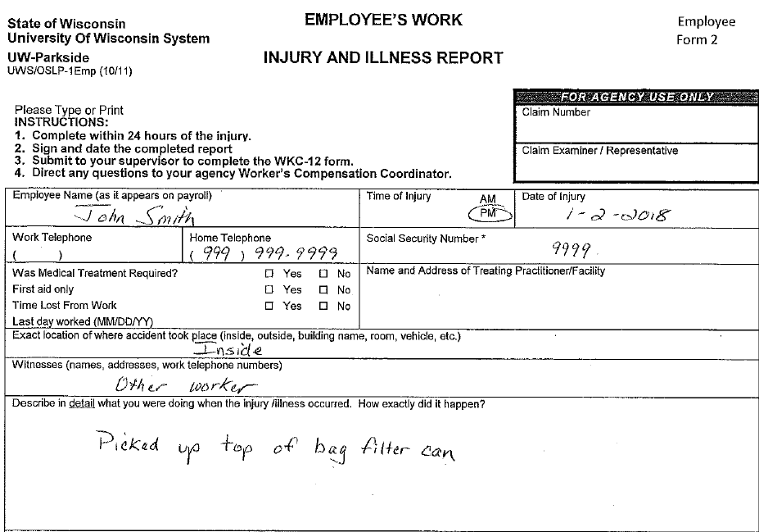
ASSIST
Review the Form for
Missing,
Vague, or
Incomplete answers
Notes:
This first exercise provides experience completing the forms (EE forms as well as Supv forms)
Divide into groups
Each group will have a form completed by an employee.
Each group review the form and identify missing, vague or incomplete answers and report out
Follow Up Questions
When would you have opportunity to review with employee?
How could you assist them in modifying form?
SSN – only last 4 digits (sometimes forms are email’d, faxed or snail mail’d to HR – keep confidential info confidential by providing enough but not too much)
Consider the info you will need to complete your forms

Slide 27
INVESTIGATE
Ask
Who
What
When
Why
Where
How
Was PPE issued and worn?
Emphasis to find the root cause
Prevent future incidents (i.e., how can this be avoided in the future?)
Find the facts that lead to corrective action
Reinforce positive behavior & expected behavior
Reduce lost time
Emphasis on early return to work
Seek to understand - not place blame
Notes:
Speaker’s Notes:
Identify one member of your group as the employee.
Interview them about the incident and use that information as a group to complete the Supervisor Accident Analysis, Repetitive Motion and Supervisor Question forms
As the individual being interviewed to more fully complete the EE form

Slide 28
Report
Phone or email details of incident
Complete Packet:
Employee’s Work Injury & Illness Report
Supervisor Accident Analysis & Prevention Report
Repetitive Motion or Material Handling
Supervisor Questions
Notes:
Speaker’s Notes:
REPORT INCIDENT – Phone, email or stop by with info regarding incident; HR and Grieshaber; include Police if off hours and need assistance when neither HR nor Grieshaber are available
FORMS - Get to HR as quickly as possible.
Preference Order
Drop off the forms in HR office
Fax the forms to 262/595-2693
Email the forms (so long as no confidential data i.e., full SSN, etc.)
Interoffice the forms (only if incident only – where urgency is less)

Slide 29
Scenario 1
Overheard team conversation
“Yeah. Those stairs are an accident waiting to happen.”
“Joe fell on them just last month.”
Joe is on your team and this is the first you heard of this fall.
Notes:
Speaker’s Notes:
These scenarios present some circumstances which may concern you. Remain in your groups and have a quick conversation to determine:
What concerns do you have with this scenario?
Why didn’t he report?
Was he hurt? Did he receive treatment?
Did he miss work as a result of this fall?
How did the fall happen?
Was he alone when he fell? Witnesses?
Is this a unique situation or are others not reporting incidents? Does this provide you with an opportunity to improve the culture of safety on your team?

Slide 30
Scenario 2
Employee reports that while stripping the floor two days ago, chemical splashed on his foot. He shows you a nasty chemical burn which has not yet been treated.
Why didn’t you report your injury?
“I didn’t think it was serious.”
Notes:
Speaker’s Notes:
What concerns do you have about this scenario?
Did he receive treatment for the injury?
Has delayed treatment resulted in a more serious situation?
Did he follow work rules relative to personal protective equipment?
Why should the employee be concerned about late reporting? Is it possible the burn could have happened outside of work?
What value is there in reporting an incident you don’t think is serious?
Do you need to send the employee to a medical provider for checkup?
Has the employee failed to follow safety procedures by not wearing sufficient foot protection?

Slide 31
Scenario 3
You learn that an employee you supervise tumbled down some snow-covered stairs on her way to a meeting in another building.
When you arrive on the scene, the employee, looking pale, is sitting on the stairs and appears to be somewhat confused about the fall.
“Do you have someone who can pick you up and drive you to Urgent Care?”
“No, I live alone.”
Notes:
Speaker’s Notes:
What concerns do you have about this scenario?
Do you need to assist your employee obtain medical assistance?
How will she reach the ER, Urgent Care or medical provider?
Which of your resources should you contact?
Should you call 2911 and get the campus police involved?
Is she alert enough to complete the form? Can you safely interview her while she is waiting for transport?
Is Facilities or Residence Life aware of the snow/ice covered stairs?

Slide 32
Scenario 4
PROPER
LIFTING
TECHNIQUE
An employee on your team was lifting a heavy box to move to another room when he felt a pop in his back.
When you asked him to describe the incident, he described incorrect lifting technique, something you had coached him on in the past and on which he received formal training.
Notes:
Speaker’s Notes:
What are your concerns about this scenario?
What should your first priority be in this discussion? His health, need for medical attention, safety issue, coaching/disciplinary, other?
What options do you have to address the safety issue with the employee? Retraining, coaching, write up,
How could you use this as a coachable moment for your team?
What did the employee do immediately after he felt the pop?
Was there a witness?
How does your team determine whether they can move/lift objects by themselves or require another team member?

Slide 33
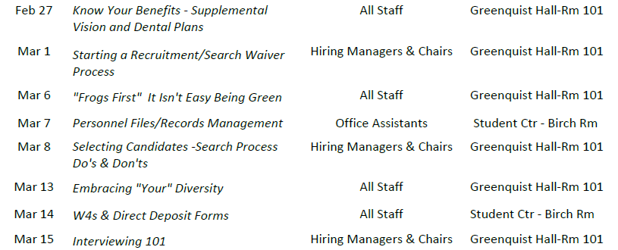
Notes:
Speaker’s Notes:
This last slide promotes some of the upcoming Lunch & Learn sessions through mid March.
Special mention of the FMLA sessions for employees followed by an FMLA session for Supervisors coming up March 20 and March 22 (respectively). FMLA and WC often intersect if an employee is expected to miss more than 5 consecutive days or will need to be away from work intermittently due to injury/illness that is work related. This session will provide more information about an FMLA leave (which can run concurrently with a WC leave) as well as stand-alone FMLA leave.

Slide 34
Notes:
Speaker Notes:
Thank you for taking time from your schedule to attend this training. We know everyone is busy.
We want to make sure that we use your time wisely, so we’d like to continue to improve this training. Do you have questions you’d like addressed during future sessions? Do you have scenarios you’d like us to present/address? Send your feedback on this session via email to hr@uwp.edu

