Slide 1

Interviewing 101
Presented By
Jessica Terwilliger
Recruitment and Staffing Coordinator
Human Resources
Notes:
The goal today is to talk about the interview from the employer perspective

Slide 2
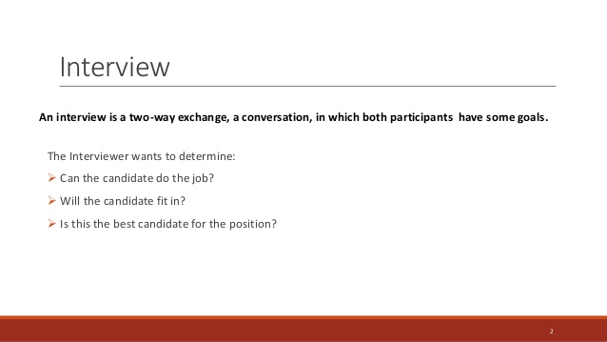
Notes:
What is an interview?

Slide 3
Key to a good interview
The key to a good interview will always lie in your ability to avoid common hiring mistakes and assess potential talent in the interview process.
But keep in mind that more new hires fail due to personality-culture mismatch than technical skills mismatch, so keep a keen eye out for compatible styles in terms of communication, pace, constructive criticism, and work hour commitments in candidates’ responses.
Notes:
We want to make sure we are making the right match, not only for us, but for the candidate

Slide 4
Assess the Candidate’s Desire Factor
Did the candidate research your company, its achievements, competitors, and challenges prior to an interview. Still, some will go out of their way to articulate their understanding of who you are and why they’re so excited about joining your firm. Try questions like these to isolate those who are hungriest for the opportunity that you offer:
Why would you want to work here, and what do you know about our organization?
What makes us stand out in your mind from our competitors?
How would this role with our company provide a link to your future career progression?

Slide 5
Behavioral Interviews
A behavioral question (behavior-based interview questions) is a question that aims at learning about your past “behaviors” in specific work situations.
How you have “behaved” in certain situations in the past will give them clues on how you’ll behave in those same situations when working for them in the future.
Tell me about a time…..
Situation
Behavior
Outcome
Notes:
past behavior would be an indicator of their future behavior
If the candidate uses a hypothetical it may fit but also they maybe feeding into what they think you want to hear or have not had relatable experiences

Slide 6
Common Behavior Based Question Categories
Teamwork oriented
Problem solving
Initiative/Leadership
Interpersonal Skills
Challenge/stress/pressure

Slide 7
Behavioral Interview Questions
“Describe a Situation Where You Disagreed With a Supervisor.”
“Tell me about a time you had a conflict at work.”
“Tell me about a situation where you had to solve a difficult problem.”
“Describe a project or idea (not necessarily your own) that was implemented primarily because of your efforts.”
“Do you feel you work well under pressure? If so, describe a time when you have done so…”
“Give me an example of a time when you motivated others.”
“Tell me about a time where you had to delegate tasks during a project”
“Give me an example of when you showed initiative and took the lead.”
“Tell me about a time when you missed an obvious solution to a problem.”
“Tell me about your proudest professional accomplishment.”
Notes:
With these questions we are trying to get a feel for the candidate, how they would respond in certain situations and does that align with our team, department and college.
At times we want more information but not sure how to skate around those Illegal Question situations…

Slide 8
Notes:
Avoid those questions that could lead to legalities. Here are some examples and if you do need some sort of ideas in a certain area there are some ways to obtain your answer. Let’s look at a couple ways...
Example of age: Police dept. need to be 21. It is able to be listed in the Requirements as well.

Slide 9
Notes:
Stick to reciting our policies and making sure they are ok with adhering to them. Also comes into play with our work rules.
Citizenship – support person is asking, the committee is not to know that information.

Slide 10
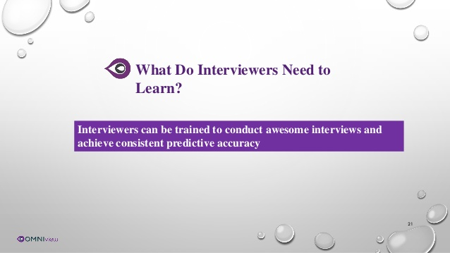
Notes:
The goal is to learn enough about the person to make a stong judgement if they will be a good long term fit for the company.

Slide 11
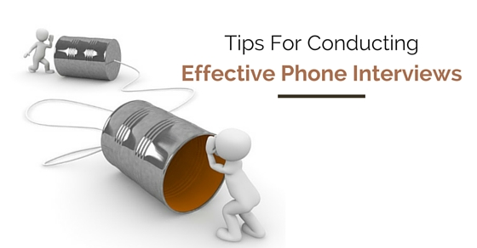
Notes:
Let’s start with the phone interview.

Slide 12
Why A Phone Interview?
Phone interviews can be a great method to get knowledge about a candidate before making a decision to get them in for an interview in person. With the help of phone interviews, hiring managers, employers and HR professionals are able to improve their opportunities of discovering the ideal employee by finding out candidates that stand out and filtering out those who are not the right fit even before a face to face interview which is particularly time consuming. Follow below tips for conducting phone interviews effectively.

Slide 13
Let’s Get Started …
1. Get all the tools ready:
Make sure you have consistent and good connection, if recording do a test run. Do maintain a notebook, pen and other noting tools. Make sure you have the phone number and any other contact details with you.
2. Prepare:
It is important to learn about a candidate as much as possible prior to an interview. You should have in front of you: the resume and any additional details that have been provided, through online application or such. Even make sure that you have the description in front of you of the job title you are hiring for, to ask them questions related to the experience they have mentioned in the provided information.
3. Know your interview questions in advance:
Know what you wish to ask and generate questions to ask at interview to acquire complete knowledge about the candidate. Keep it short and direct.

Slide 14
4. Send the candidate complete details:
Make the preparation for the candidate easy, for the interview send them complete details about the company, of the people they will be speaking to and the related phone numbers. Sharing the plan can be beneficial and helpful as well.
5. Avoid distractions:
Phone interviewing is not the moment where you can text message someone or can check e-mails. You need to eliminate any kind of distractions that you are aware can disturb you and try to focus on the interview.
6. Avoid talking too much:
A number of people are comfortable speaking in person and some on the phone. You must maintain the face to face interview principles, ask short questions and listen to the candidate throughout. This is a filtering system for both candidate and the interviewer. Keep it short and detailed so that you leave room for the in person interview to ask more questions.

Slide 15
7. Plan a structure for the interview:
It is good to have a structure for the interview, so that you do not miss out on anything, ask all the questions you wished to ask and give the candidate time for questions.
8. Create checklist:
You can even create a checklist to make sure you are on track with the structure you have prepared. It will even help you to not miss out on any part during the phone call. As you gradually conduct and get done with each step you can mark off the step from the list. Note taking is also a great idea.
9. Ideal Structure:
The ideal structure for an interview can be by starting with an introduction of you or anyone else that may be involved in the call and then follow by thanking them for their time and look for any initial concerns. Provide them with a short but sufficient introduction about the company and the role and then let them give overview about themselves. Have a transparent discussion with opportunities to clear all concerns and close it with providing details about further actions.

Slide 16
10. Be Ready for the unexpected:
Job seekers may never know when the Interviewer may ask them certain question that will be unique and odd during an interview. It goes the same for that Interviewer as the candidate during the phone interview might pop up some question out of the ordinary or says something alarming or surprising. Preparing for job interview in advance will be beneficial to give away the right and appropriate answer to any rare situations arising.
11. Maintain flexibility:
An interview is a two way process. It is as crucial to selling you and the job as much it is about assessing the candidate’s eligibility. Competent candidates will have numerous offers and options to choose from and hence be flexible from the beginning itself to make it painless for them to speak to you.
Notes:
So these are all good tips to consider not only during the phone interview but in our next stage which is the in person interview.

Slide 17
Interviewing Tips for the Interviewer
Have your list of questions prepared
Use those behavioral questions
Review the candidates Resume/credentials
Extend professional courtesies, ex water..
Watch those nonverbal signals
Keep polite and professional
Follow up
Notes:
Know your questions and keep to them to avoid going Rogue
Again behavioral questions are going to give you the best predictor
Gain knowledge of the candidate be reviewing there resume, this will help you understand where they may be referring to with there answers
Non verbals are key, this will help you determine more about the candidate
Follow up is key, if you have a timeline share it.

Slide 18
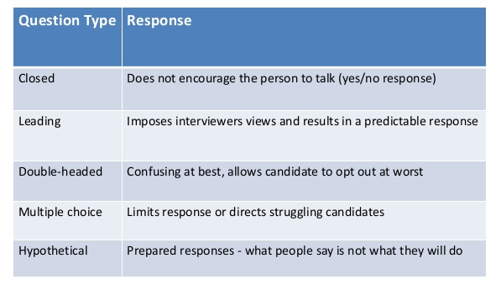
Questions to Avoid
Notes:
Avoid these types of questions, they are not going to lead you to finding out what you actually need to know

Slide 19
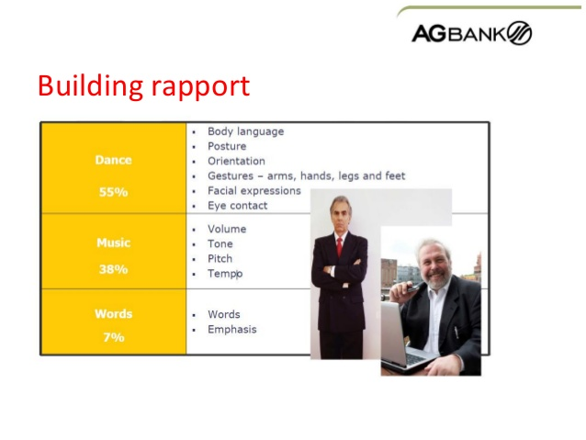
Building Rapport
Notes:
You want to build rapport during the interview, allows candidate to feel more comfortable and open up more.
As you see body language plays a big part in the interview evaluation process.

Slide 20
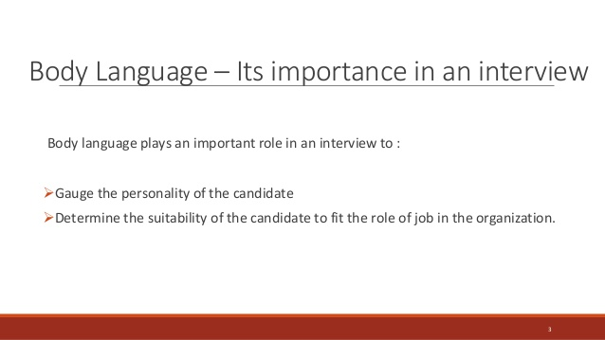
Notes:
Body language can say “I like you” “I don’t like you”
Could show you are impatient --talk fast, waving hands
Slouched shoulders- overwhelmed
Touching your heart- compassionate
Lack of eye contact while leaning back, blinking, scratching arms/nose or stammering leads to make you think you probably have a liar on your hands

Slide 21

Choose who you would like to offer!
Evaluate specific evidence which the candidate shared, be sure you are not bringing in any biases
Gage there behavioral traits and skills
Avoid the charisma trap
High value on attitude, work ethic and motivation
Learn from your personal past hiring processes
Notes:
You want to look at the specifics that were given in the interview. Evaluate what was said, not what you think they meant.
Look at there traits and skills, how was there body language, what skills have they obtained, what would be the most useful to the team
Attitude is big, if you have someone with the glass half full approach it can spill over to the team
Motivation is also a big factor, it can be contagious
And learn from your past hiring processes, what type of experience has worked the best or the worst

Slide 22
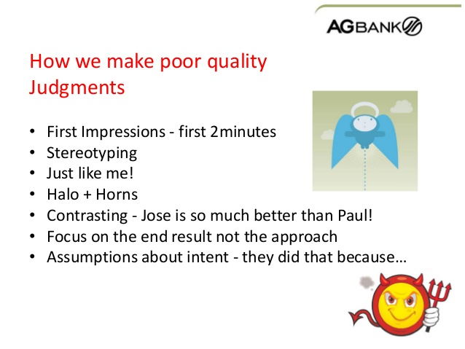
Notes:
And we want to do all of this without any biases.
We want to treat each person equal and for there own strength and weaknesses. And just because it is a weakness it doesn’t mean that it is a bad trait. Sometimes it is for the better or give a teaching opportunity

Slide 23
Why the Right Hire is Important
Replacement of an employee
can range from two to seven times his/her salary
Notes:
So pick your strongest candidate and be sure to follow thru with the hire process. It’s not done here. We have to orientate them, train them properly and give them the tools to succeed.

Slide 24
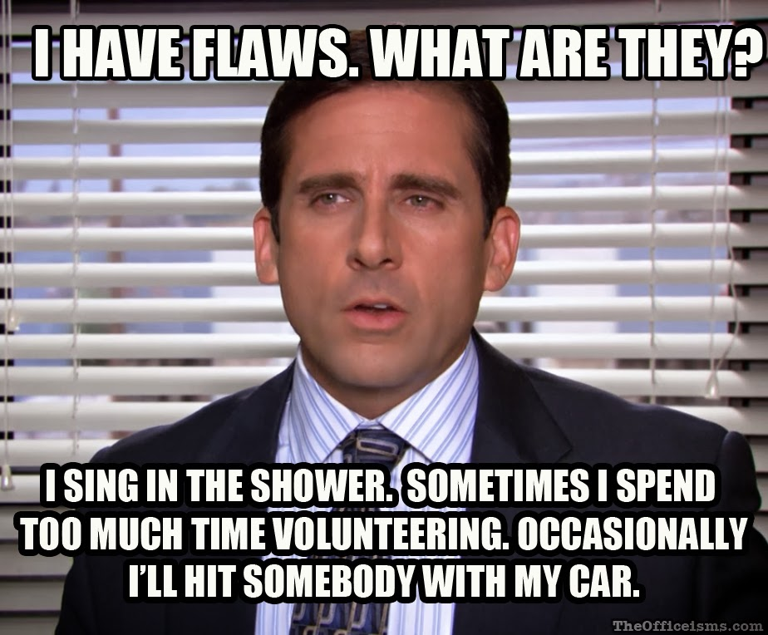
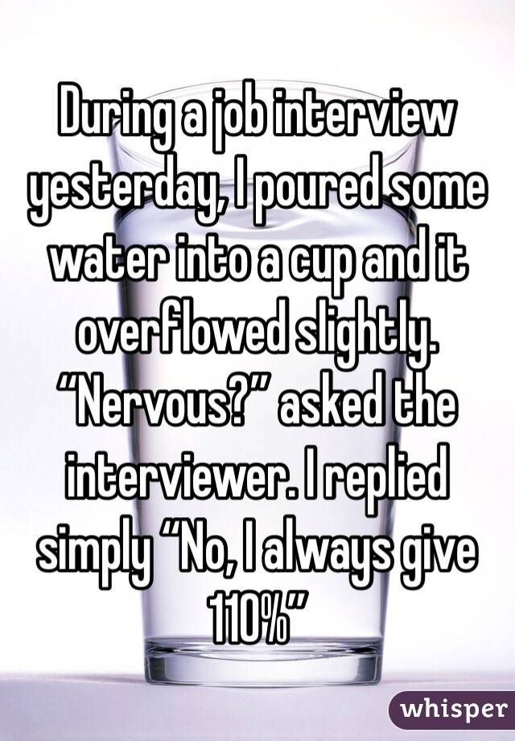

Slide 25


