Slide 1
Understanding Your Dental and Vision Benefits
Presented By
Amy Chostner
Payroll & Benefits Specialist
Human Resources

Slide 2
Uniform Dental Benefits
Only available if you enroll in a State Group Health insurance program.
No deductible
Annual Maximum Benefit $1,000 per year per member
$3.00 per month single / $6.00 per month family
You must utilize an in-network provider to obtain coverage. (Delta Dental)
Notes:
Speaker’s Notes:
CLICK TO THE NEXT SLIDE

Slide 3
Uniform Dental Benefits - Coverage
Diagnostic and Preventative: 100%
Routine Exams, X-rays, and Fluoride Treatments
Restorative: 100%
Fillings – Silver only unless front teeth. If you have a composite or resin filling on a proterior tooth you will be responsible for the cost difference.
Periodontics: 80%
Maintenance Only
Adjunctive Services: 80%
Anesthesia
Orthodontia: 50% (children only) Lifetime Max $1,500
Notes:
Speaker’s Notes:
CLICK TO THE NEXT SLIDE

Slide 4
Uniform Dental Benefits – New in 2018
Evidence Based Integrated Care Plan (EBICP)
You must set the appropriate health condition indicator online or call Delta Dental.
Phone: 1-800-236-3712
Online: deltadentalwi.com/state-of-wi
Allows for additional dental visits, based on condition for adult prophylaxis or periodontal maintenance.
Notes:
Speaker’s Notes:
Conditions covered under EBICP – Periodontal Disease, Diabetes, Pregnancy, High Risk Cardiac Conditions, Suppressed Immune System Conditions, Dialysis Conditions, Cancer Related Chemotherapy and / or Radiation.

Slide 5
Dental Wisconsin
Two plans available
PPO
Coverage in and out of network
Select
Coverage in and out of network
Notes:
Speaker’s Notes:

Slide 6
Dental Wisconsin
Both plans are administered by EPIC.
Both plans utilize the Delta Dental Network for in network coverage.
Both plans offer coverage for major services that are not covered by the Uniform Dental Plan.
Both plans include the Davis Vision Affinity Program.
Both plans are subject to waiting periods
If no prior dental insurance.
Notes:
Speaker’s Notes:

Slide 7
Dental Wisconsin
Annual Benefit Maximum
$1,000 per person
Ortho Lifetime Maximum (under age 19)
$1,000
Deductible
Select: $50
PPO: $25 In Network / $50 out of network.
Notes:
Speaker’s Notes:

Slide 8
Dental Wisconsin
Coverage
Basic Services: Up to 75%
Major / Restorative Services: Up to 50%
Ortho Services: Up to 50%
Waiting Periods
Basic Services: 3 months
Major Services: 3 months
Ortho Services: 12 months
Notes:
Speaker’s Notes:

Slide 9
EPIC Benefits +
Supplemental Benefit Plan
Available with or without additional vision options.
Includes all of the following benefits:
Dental
Hospital / Surgery
AD&D
Vision
Notes:
Speaker’s Notes:

Slide 10
EPIC Benefits +
Dental
Subject to reduced benefits if you do not enroll until the annual benefit enrollment period.
May use any provider, but larger discount when using a Delta Dental network provider.
No waiting period for Basic and Major Services.
12 month waiting period for Ortho Services.
Under 19 years old
Notes:
Speaker’s Notes:

Slide 11
EPIC Benefits +
Dental
Annual Benefit Maximum
$1,500 per person
Ortho Lifetime Maximum (under age 19)
$1,200
Deductible
$75 per member
Notes:
Speaker’s Notes:
.

Slide 12
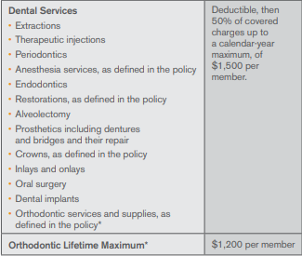

Slide 13
EPIC Benefits +
Hospital / Surgery
Inpatient Hospital Stay
$200 per day beginning on the 3rd day and continuing through the 365th day of hospital confinement.
Does not include confinement of a skilled nursing facility.
Outpatient Surgery
$200 per out patient surgery when preformed in a hospital outpatient department or freestanding Ambulatory Surgical Center.
Surgery preformed at a physician’s office does not qualify for this benefit.
Benefits are not subject to a waiting period.
Payment is made directly to the member.
Must complete an EPIC claim form to collect benefit.
Notes:
Speaker’s Notes:

Slide 14
EPIC Benefits +
AD&D (Accidental Death and Dismemberment)
Employee
$15,000 – Life, both feet, both hands
$7,500 – One foot, one hand, sight in one eye
Spouse
$7,500 – Life, both feet, both hands
$3,750 - One foot, one hand, sight in one eye
Child
$3,000 – Life, both feet, both hands
$1,500 - One foot, one hand, sight in one eye
*Loss must occur within 90 days of injury.*
Notes:
Speaker’s Notes:

Slide 15
EPIC Benefits +
Vision (only if selected – additional cost)
Davis Vision Network
www.davisvision.com Select Members and enter client code 7745
Members are subject to specific co-payments for frames, lenses, and upgrades.
Limited benefits are available outside of the network.
No coverage for routine vision exams.
If enrolled in the State Group Health insurance plan you may obtain a vision exam through your health insurance provider. $25 co-payment.
Notes:
Speaker’s Notes:

Slide 16
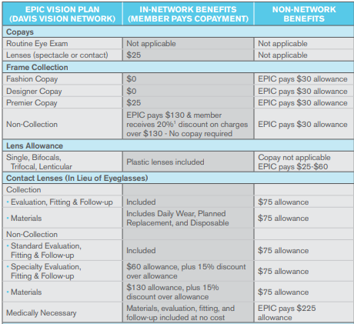

Slide 17
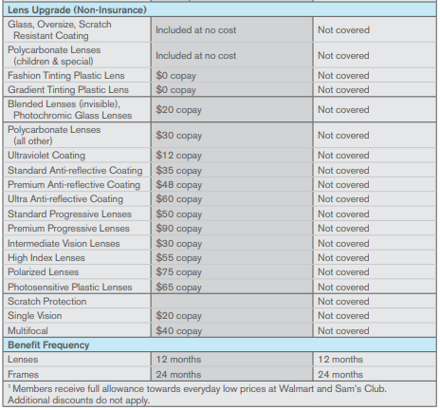

Slide 18
Davis Vision Affinity Program
Included with the following plans:
WI Dental PPO, WI Dental Select, and EPIC Benefits + without vision coverage.
No additional cost
This is not an insurance plan. This is a discount program.
To find a provider visit:
www.davisvision.com Select Members and enter client code 7748
You may also print a listing of the discount benefits at this site by clicking Access Benefits and Forms on the welcome page.
.
Notes:
Speaker’s Notes:

Slide 19
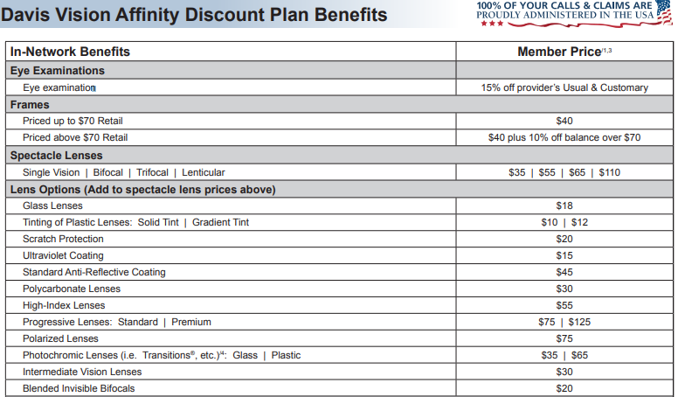

Slide 21
VSP
Vision insurance plan
No ID card is necessary
Your VSP ID# is your employee ID# with an additional 0 on the front of your ID #. Your employee ID# may be accessed in your portal at anytime.
To find a provider:
Call 1-800-400-4569
Visit: stateofwiemployees.vspforme.com
Benefits will be limited if utilizing an out of network provider.
Notes:
Speaker’s Notes: Emp ID can be found on the top of your earnings statement

Slide 22
VSP
VSP Kids
Well vision exam twice per year
New frames every calendar year
Polycarbonate lenses
Primary Eye Care Plan – New in 2018!
$20 copayment with an in network provider
What is covered?
Treatment for eye pain, or conditions like pink eye
Tests to diagnose sudden vision changes
Pictures of your eyes to detect and track eye conditions
Exams to monitor cataracts
Retinal screenings
Notes:
Speaker’s Notes:
Retinal screenings are for eligible members with diabetes.
Polycarbonate lenses are 10 time more impact resistant than plastic or glass lenses and they provide 100% protection from UV light.

Slide 23
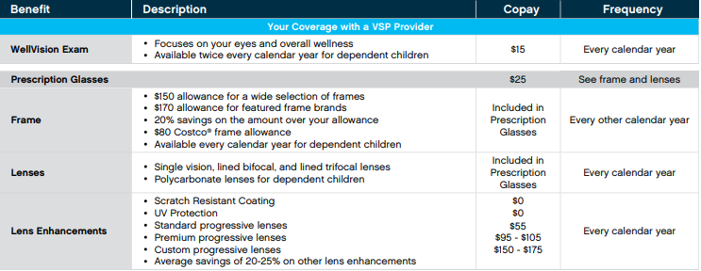
VSP
Notes:
Speaker’s Notes:
Retinal screenings are for eligible members with diabetes.

Slide 24
VSP
Notes:
Speaker’s Notes:
Retinal screenings are for eligible members with diabetes.

Slide 25
Tips
If you have more than one dental plan claims should be submitted as follows:
First: Uniform Dental or WI Dental PPO
Second: WI Dental Select or EPIC Benefits +
Last: EPIC Benefits+ (If you have three dental plans)
Utilize the Delta Dental Network
Larger discounts are available if you utilize providers listed in the Delta Dental PPO network – providing members the largest savings.
Delta Dental Premier network providers offer lower fees, but not as low as providers in the PPO network.
If using out of network providers you are responsible for the balance of the contracted rate.
Utilize online member services
Grin Magazine, tooth brush timer, and cost estimator available with Delta Dental Online
Notes:
Speaker’s Notes:
Even if you may use any provider you wish special rates have been negotiated with Delta Dental which will result in lower out of pocket costs for members.

Slide 26
Tips
Select plans that are right for your needs.
You can mix and match coverage levels each year during open enrollment.
Review your usage of your plans each year.
Based on your usage should you continue with your current selections?
Premium costs vs. costs of services to be provided.
Consider your options
Plan your preventative care visits. Ask questions.
Consider enrolling in a Flexible Spending Account during the annual benefit enrollment period to offset the costs of your copayments.
If you are enrolled in a High Deductible Health Plan you may utilize Health Savings Account dollars to pay for medical and dental expenses.
Notes:
Speaker’s Notes:
You may enroll in some plans as a family or others as employee spouse or employee child.
Do the premiums you pay outweigh the services you are receiving.

Slide 27
Where to get help
Need more help?
Human Resources Department
Online: Human Resources – Benefits https://www.uwp.edu/explore/offices/humanresources/benefits.cfm
Amy Chostner Ext. 2537
Alex
Link: https://www.myalex.com/uwsystem/2018#intro
Alex is available 24 hours / 7 days a week to help you learn more about your benefit programs.
UW System Portal
Benefit and Payroll Resources
Notes:
Speaker’s Notes:

