Slide 1
Making the most of a Multi generational Workplace

Slide 2
Definition of Generation
Generation: noun — all the people living at the same time, or of approximately the same age.
Notes:
Since we are now working for the first time in an environment when fully 4 generations of employees may be working together in one workplace, it is important to understand what makes each generation tick and how to use this knowledge to better manage cross generational employees and co-workers.
All 4 generations represent a span of 60 years, from those born in the late 30’s, many of whom are still actively working today all the way up to today’s 20 year olds, born in the 1990’s.
Ask the audience for a few comments on how relevant is this topic to them? What have they noticed? In other words..why are we here today!

Slide 3
Objectives
Identify the four generations, and the characteristics and motivations of each
Explore how members of each generation work
Discuss how each generation affects you
Examine how to use generational differences to make your workplace more productive for all employees
Notes:
Each generation has a unique mix of characteristics shaped by the experiences that define them as a generation.
Each generation brings valuable assets to the workplace and varying perspectives which when used constructively can improve the productivity of the workplace.
Leadership style preferences are also strongly influenced by the generation.
The goal of this seminar is to better understand what influences each generation, how it effects the way they work, how it effects you as a co-worker, supervisor or subordinate and how your understanding of these differences can make cross generational work experience more satisfying and positively impact your bottom line.

Slide 4
The Four Generations
Traditionalists - born: 1922-1945
Aka – GI’s, Silent Generation, Veterans
Baby Boomers – born: 1946-1964
Generation X – born: 1965-1980
Millennials – born: 1981 – 2000
Aka — Gen Y
Notes:
The breakdown of the generations represented are approximately Traditionalists 8% - Baby Boomers 44% - Gen x-ers 33% and Millenials 15%.
Each generation is identified by when they were born and defined by the experiences and events during the formative years of that generation. This in turn influences their perspectives, expectations and work styles.
In the following slides we will examine each generation individually – allow participants to relate to their generation and discuss what experiences, in addition to those listed, have shaped them as a generation. We do need to be cautious of stereotyping all people based on these descriptions as there also people between these generations – or “tweeners” who may take on some characteristics of two generations.
Who were the social leaders of the time?
What was the political environment?
What music did they listen to, what TV shows did they watch - or did they even have TV??
Later we will discuss what the best practices for managing this group of employees and the strengths each brings to the workplace.

Slide 5
Traditionalists 1922-1945
Experiences
World War II
Great Depression
Life-time employment
Men, dominant; women, subservient
Little to no technology
Very beginning of TV; had minimal impact
Popular music — Big Band and Patriotic songs
Traits
Respect for authority
Patriotism
Patience
Hard work
Stability
Stoicism
Notes:
Also known as the GI generation. Note: 8% of these are internet users.
How might these milestones have effected this generation:
1928 Sliced bread invented
1929 Crash of the stock market
1933 Prohibition ends
1935 Alcoholics Anonymous founded
1945 US drops atomic bomb

Slide 6
Generation “X”ers 1965-1980
Experiences
End of Vietnam War
“Latch Key kids”
Increased Divorce Rate
1980’s Layoffs
Title IX
Rise of technology — changes how many jobs are done
Traits
Distrustful of authority
Independent
Creative
Adaptable
Team-oriented
Social-minded
Structured
Notes:
Milestones for Generation X - 35% are internet users.
TV Show: M*A*S*H*
Movie: The Graduate
1966 Star Trek
1974 Nixon resigns
1977 Elvis dies – Star Wars released.
Generation X-er’s are distrustful of authority and will challenge the status quo – not afraid to rock the boat.
Most will have 7 or more careers during their life if not more.

Slide 7
Millennials – Generation “Y” – 1981-2000
Experiences
End of Cold War
Desert Storm
World Wide Web
Global Warming
Terrorist Attacks
Traits
Optimistic
Multi-taskers
Tenacious; confident
Technologically savvy
Socially responsible
Notes:
40% are internet users
MOVIE: ET – the Extra Terrestrial
1992 – End of the Cold War
1995 – Oklahoma City Bombing
1997 – Tiger Woods wins Masters
1999 – Columbine
2000 – Y2K fear unfounded

Slide 8
Baby Boomers 1946-1964
Experiences
Space Race
Korean and Vietnam War
Civil Rights Act
TV Generation
Rock and Roll
Assassination of JFK
Women’s Liberation
Traits
Question authority — anti-establishment
Dedicated — driven
Idealistic
Experienced
Knowledgeable
Service-oriented
Notes:
33% of these people are internet users.
Among the events that shape the Baby Boom generation is the Vietnam War which creates among the Baby Boomers an increase in challenging of authority. Less loyal to one employer, they become more focused on personal career goals and may change jobs more readily than their parents would have. Women begin to compete for equality in the job market after the passage of Title IX and the focus on women’s rights and a push toward equal pay for equal work.
How might these milestones defined this generation?
1951 Color TV Introduced
1956 Elvis appears on Ed Sullivan Show
1958 “Peace” symbol created
1964 The Beatles

Slide 9
Statistics on Internet Use
59 percent of Millennials consume most of their news via the Internet
53 percent of Gen Xers get most of their news from the Internet
Social Networks, since 2005 :
Millennials increased their use of social networking sites from seven percent to 75 percent
Gen Xers' use of social networking sites grew by 43%
Boomers’ use increased by 25 percent
Traditionalists went from negligible use in 2005 to four percent in 2008 and 16 percent currently
Notes:
Source: The National Journal October 28, 2010

Slide 10
Work Style By Generation
Traditionalists: Work hard, value putting in long hours; show up; put work first.
Baby Boomers: Are dedicated; see teamwork and meetings as important; collaborate; are service oriented; value work/life balance.
Generation X and Millennials: Are creative, techno-literate; want their contributions valued regardless of actual time put in; value results over hours worked; exhibit a free spirit; demonstrate Monster, Apple and Google work styles.
Notes:
Ask the people what they can learn from each of these generations? What value do they bring to the team?

Slide 11
Managing Traditionalists and Boomers
Traditionalists
Want respect for their contributions and knowledge
Are detail-oriented; a valuable offset to less experienced workers
May need to learn team approach
May need help with technology skills, or extra time to adapt and accept new technology
Baby Boomers
Like face-to-face interaction and consensus building
Are process-oriented
Seek high achievement and personal gratification — recognition is a motivator for baby boomers
Notes:
Although Traditionalists and Baby Boomers have very different motivations it is often easier for them to find common ground than with the non-traditional style that Generation X & Y or Millennials bring to the table.
Baby boomers are often mystified by the way the next generation sees itself at work – and will need to see the worth in their non-conforming work style and what it brings to the workplace – by harnessing the positive energy and creativity and incorporating it into the corporate fold.

Slide 12
Managing Generation X’ers and Millennials
Need flexibility to be creative which can lead to high productivity.
Desire immediate feedback
Dislike micromanaging
Want clear direction
Want freedom and flexibility with the “how” to do their work
Crave increased responsibility
Benefit from assistance with time management (Facebook is the new “water cooler”)
Define long-term, for Millennials, as a year or two
Notes:
The newest and fastest growing members of the workplace can be valuable employees but need to be managed very differently.

Slide 13
Managing Differences Effectively
Respect differences and try to reasonably meet needs
Manage flexibly — offer choices and options
Respect contributions from all employees, based on their strengths, as they contribute to your goals
Work to retain good employees by strengthening their weaknesses and growing their strengths
Keep communication open and non-judgmental
Allow information to flow through all levels of management and staff

Slide 14
Your Kepro EAPur Kepro EAP
EAP Services available to employees, any household members and dependents
Confidential
EAP Counselors available 24/7/365 via 833-539-7285
Up to 6 in person counseling sessions, per issue, per year
Management Consultations
Financial/Legal Consultation and Referral Service
Work/Life & Convenience Services
https://sowi.mylifeexpert.com Company code: SOWI

Slide 15
Questions & Answer
Making the Most of a Multi Generational Workforce

Slide 16
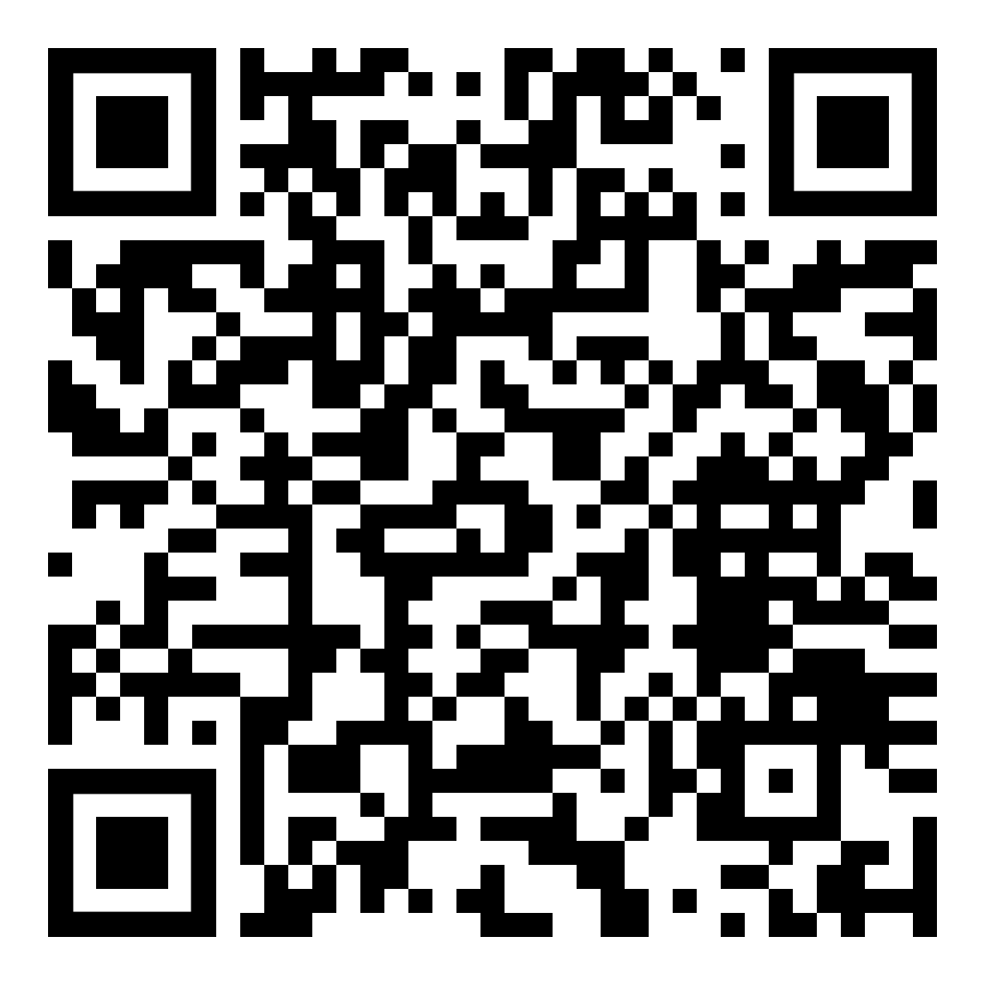
Please complete a training evaluation. Thank you!
Thank you!
https://app.smartsheet.com/b/form/dacb2d9b38564db4afb5ab8426d91ad6
Notes:
Please scan the QR code to be taken directly to the training evaluation or right click on the link (open hyperlink) and it will take you directly to the survey. Thank you!

