Slide 1

New Hire Orientation
The Red Carpet Experience
Presented By
Dalinda Galaviz
Human Resources
Notes:
How important is onboarding a new hire correctly? Let’s talk about the statistics done by SHRM … here are cost for turnover …
$10/hr cost up to $3,328
40K cost up to $8000
100K cost up to $213K
What is the cost of losing an employee:
Hiring a new employee – advertising, interviewing, screening and hiring
Onboarding – training and management time
Lost of productivity – it takes an employee one to two years toe reach the productivity of an existing person
Lost engagement – others see high turnover and they are contemplating leaving
Customer service and errors – not able to solve the problem quickly
Training costs – companies invest 10 to 20 perscent of an employees salary in training
Cultural impact – why
An important part of retention is ensuring the employee has been onboarded properly and given the tools, etc to succeed.

Slide 2

New Hire
Orientation
The Role of
Department

Slide 3
You Are Welcome Here!
https://youtu.be/zYaXdcHiqsc

Slide 4


Notes:
Give a handout of the Mission and Vision of UW-Parkside. We

Slide 5


Diversity and inclusion have played important roles in shaping the University of Wisconsin-Parkside. With great intention, Parkside has created a learning environment that celebrates diverse knowledge and perspectives through academics and partnerships in our communities. The result: Students are better prepared to be effective contributors in today's multicultural society. Parkside's classroom environment promotes individualized attention that speaks to both traditional and nontraditional students.
Parkside offers you a quality university experience that goes beyond the classroom. Our top faculty members teach all levels of undergraduate courses. They become your mentors, engage you in their own research, and are actively involved with businesses, groups and organizations in our region. Our student-to-faculty ratio is just 18 to 1, and more than three quarters of the classes offered have fewer than thirty students.
Notes:
UW Parkside is proud to be the most diverse campus in the UW System.

Slide 6

"Parkside is a perfect example of the Wisconsin idea … bringing the university to the people. And the people of this region have demonstrated that they want it.“
Fred Harvey Harrington, University of Wisconsin President, 1970
University of Wisconsin presence in southeastern Wisconsin since 1933
In 1965, UW Parkside was created in Kenosha and Racine
Chancellor Irvin G. Wyllie selected the name “Parkside” to represent the picturesque campus and to exhibit service to all of southeastern Wisconsin
Architect Gyo Obata designed the complex with a major library/learning center at its heart.
July 1, 1968, the University of Wisconsin – Parkside was officially founded.
Our President of UW Parkside is Chancellor Deborah Ford
Notes:
During the tenure, Chancellor Wyllie was often asked, “When will the campus be complete?” His response was always” … Never. Harvard, America’s first university was founded in 1937. It is still a developing university, as Parkside will be through many years and many future generations.

Slide 7

Supervisor’s Role

Slide 8
New Hire Orientation
The Role of the Supervisor
Plays a pivotal role
Provides factual information and clear and realistic performance expectations
Emphasize the employee’s likelihood of succeeding at UW Parkside
Encourages newcomers’ acceptance by coworkers
Notes:
Employers have to realize that orientation isn’t just a nice gesture put on by the organization. It serves as an important element of the new employee welcome and organization integration.
To Reduce Startup Costs: Employee get up to speed much more quickly, thereby reducing the costs associated with learning the job.
To Reduce Anxiety: helps provide guidelines for behavior and conduct, so the employees doesn’t have to experience the stress of guessing.
Employee Turnover: Increasing t.o. if an employee doesn’t feel value or do their job. Orientation is a way of showing value and have the tools to succeed.
Save Time for the Supervisor: Cover everything instead of going over things as it happens. More efficient.
Develop realistic job expectations …: We all want to know the expectations and what to expect of others while learning about the company.

Slide 9
What is the purpose of New Hire Orientation
To Reduce Startup Costs
To Reduce Anxiety
To Reduce Employee Turnover
To Save Time for the Supervisor
To Develop Realistic Job Expectations, Positive Attitudes and Job Satisfaction
** A thoughtful new employee orientation program can reduce turnover and save an organization thousands of dollars.**
Notes:
Employers have to realize that orientation isn’t just a nice gesture put on by the organization. It serves as an important element of the new employee welcome and organization integration.
To Reduce Startup Costs: Employee get up to speed much more quickly, thereby reducing the costs associated with learning the job.
To Reduce Anxiety: helps provide guidelines for behavior and conduct, so the employees doesn’t have to experience the stress of guessing.
Employee Turnover: Increasing t.o. if an employee doesn’t feel value or do their job. Orientation is a way of showing value and have the tools to succeed.
Save Time for the Supervisor: Cover everything instead of going over things as it happens. More efficient.
Develop realistic job expectations …: We all want to know the expectations and what to expect of others while learning about the company.

Slide 10
Include in Your
New Employee Orientation
Commitment to continuous improvement & learning
Payoff for the individual employee, department and UW Parkside
Employee’s being the organization’s greatest resource … so ask them
What do they like or not like about orientation
Trust in your employee’s feedback
Benefits
Notes:
Employers have to realize that orientation isn’t just a nice gesture put on by the organization. It serves as an important element of the new employee welcome and organization integration.
Commitment … : Employee feels comfortable with asking questions to obtain the information that they need to learn, problem solve and make decisions.
Payoff … : Employee, department and UW Parkside feels a sense of a long term commitment,
Employee Greatest Resource: Get feedback from their employees how we can improve processes and procedures. Their opinions matter to the success of the department.
Like or not like: What is important to them to learn about during orientation.
Trust … : Leadership being open to feedback and investing in the changes. Communicating those changes to the employees and thanking them for their feedback.
Benefits

Slide 11
What is The Red Carpet Treatment?
Feel welcomed
Smooth integrate into UW Parkside
Have the tools and resources to perform their job successfully
Have targeted goals
Make the first day a celebration
Make new hires productive on the first day
It’s not boring, rushed or ineffective
Discuss the expected contributions and how they will help UW Parkside (how they fit in)
Notes:
If your new employee orientation incorporates these factors, you know that you are on right path to an effective orientation that both welcomes and teaches your new employees.
At its best, the process of new employee orientation solidifies the new employee’s relationship with your organization. It fuels their enthusiasm and guides their steps into a long term positive relationship with you.
How we offer feedback for making improvements … Open Door Policy.
Done poorly, your new employee will leave thinking and wondering why on earth they walked through the door.

Slide 12
Common Mistakes . . . Be Prepared!
Work area created or assigned.
Schedule the new hire to start when the Manager is out or on vacation.
Leave the new hire in the reception area for a ½ hour.
Leave the new employee at their workstation.
Give the employee the paperwork in a noisy area to sign off on paperwork.
Show the new employee his office/cube and not introduce them to coworkers.
Showing all day orientation videos
Notes:
A company’s positive first impressions can cement the deal for a newly recruited employee. Those positive strokes can also speed integration and productivity. Research shows that good orientation programs can improve employee orientation by 25%.
Questions to ask yourself …
What do we want to achieve during new employee orientation
What first impression do we want to make?
If you can avoid these obvious turn offs when you have a new employee start a new job in your organization, you are taking the needed steps to ensure the new employee's success. You are paving the way to ensure her long-term contribution. That's a win-win situation for all of you.
Work area: Let them sit in the hall, share a cube while you scramble to create a work area. Worst is not giving a new employee a home. Caring?
Scheduling the first day: Not giving them meaningful work or training while the manager is out. In general, the manager should start their first day with their manager.
Leave the new hire out in the reception area: The front desk figuring out what to do with them. Employees need to welcome a new employee in an informed, supportive way. All employees should know who new is starting prior to the new hire starting.
Employee at workstation: they manage on their own, while coworkers pair up and head out to lunch. Schedule lunches for the new employees so they meet their coworkers.
Giving paperwork: Send the paperwork a head the paperwork in advance. Make the time at work about answering questions and clarifying.
Show to cube … : Take them around and introduce them to the staff. Having friendly, interested coworkers starts new employee retention and satisfaction from the first day.
Videos: Schedule the videos may one hour a day … weeks time.

Slide 13
Common Mistakes … Be Prepared!
Assign the employee who was not aware they were meeting with the new hire.
Assign the employee to a “negative, unhappy” employee on staff
Assign the employee busy work that has nothing to do with their core job description because you are too busy to work with them.
Overwhelm them with facts, figures, names and faces packed into one eight hour day.
Failing to prepare for the new hire by not providing appropriate equipment and adequate assignments.
Notes:
Not aware of meeting new hire: Communicate ahead of time who the new hire is and give the plan
Negative, unhappy employee: Negativity is contagious. Don’t want to infect the new employee? Better yet, why do you employ a negative, unhappy, company bashing staff member at all? This may have an immediate impact on their view of your department forever.
Busy Work … : New employees feel thrive when they feel immediately valued and productive. They want to make a contribution now.
Overwhelm them … : spread out the data information throughout the week, month (priority)

Slide 14
What is Important to Review
A Safe Work Environment
The Job Description
Benefits
Who are the people they will be working with
Company Culture
The Organizational Chart
How do they fit in
Fun activities to participate in the department as well as on Campus

Slide 15
Put Our Best Foot Forward …
Welcome aboard email once the candidate has accepted the offer
Goodie bag i.e. pen or tie a balloon on their chair
Be in the office on their First Day
Intro Email to the Team
Intro Email across the Campus
Assign a mentor or buddy.
Team Meeting.
Start with a company overview and then a department overview
Follow-up with them at the end of their first week, 30 days and finally 90 day
After one month have a wrap up – have coffee or a soft beverage outside of the department
Notes:
Welcome aboard ….: Send a agenda to new associate with the offer letter so that the employee knows what to expect (HR can do this too). Keep in touch and make sure work area is ready the first day.
Goodie Bag … : pen … sign on the door Welcome!
Be in the office on their first day
Send intro email to the team when the new hire is starting and encourage them to come and say hello before their orientation.
Send an intro email to all campus with a short intro (in the week).
Assign a mentor or buddy: make introductions, show around. Let the mentor know or have sufficient time so they can make preparations. The mentoring relationship should continue for 90 days and may continue longer. Some of these relationships go on for years.
Set up a team meeting with all staff.
Start with a company overview and then the department and how they fit in
Supervisor f/u with them the end of the week, 30 days and finally 90 days … put on their calendar as an invite.
After a month … schedule a morning coffee or beverage to see how things are going

Slide 16

your journey starts here.
HR
New
Employee
Orientation
Checklist

Slide 21

New
Employee
Orientation
Checklist
Admissions
Department

Slide 27
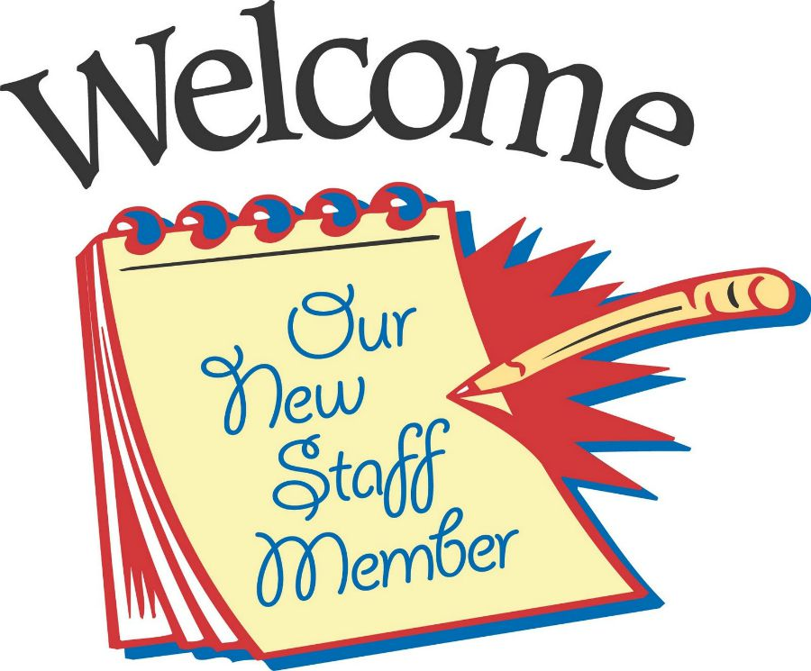
I am Welcomed, Therefore, I Belong
Celebrating a
New Employee means …
Schedule a welcome luncheon (potluck) in the department either the first day or at the end of their week.
Lunch with the Immediate Supervisor at the end of the week
Notes:
Most organizations are great at celebrating the departure of a beloved coworker. Why are we often so awful at welcoming a new employee? Celebrations produce enthusiasm.

Slide 28
Evaluate the Success
Ask for feedback on their new employee orientation after 30 days
Send out a brief, five question survey
Find out what information was overload or unneeded.
Incorporate the suggestions to improve the program
First impressions both good and bad after the first day
Other observations
Your new employee orientation is a make’ em or break’ em experience.

Slide 29
4 Simple Ways to Make Your Employees Feel Valued
Be Intentional with Everyday Conversations
Show Them that Others Need Them, Too
Challenge Them
Recognize Them as Individuals
If you want your employees to stick around.
Notes:
Be intentional … Employees and managers alike are often ingrained with the idea that “everyone is replaceable”. But I have found that a big part of feeling valued occurs when employees are aware that they add value to UW Parkside. Intentional on when you assign a task … f/u and feedback.
Show them others need them … give them feedback how others are responding to their good work.
Challenge them … say I know you are capable of doing this, and I trust you to do a great job!” Find new ways to challenge the employees … developing new projects.
Recognize … To boost team morale, its great to do something for your entire team, like catering lunch or bring donuts, but it your aiming to show your appreciation for an individual, it can easily get lost in these types of group celebrations. It’s ok to single them out and reward them according their their accomplishments – and with something that the rest of the team won’t necessarily get. Some rewards can be putting them to the side and allowing them to leave early on a Friday, small gestures can go a long way. You want to feel they make a difference to you and company.

Slide 30

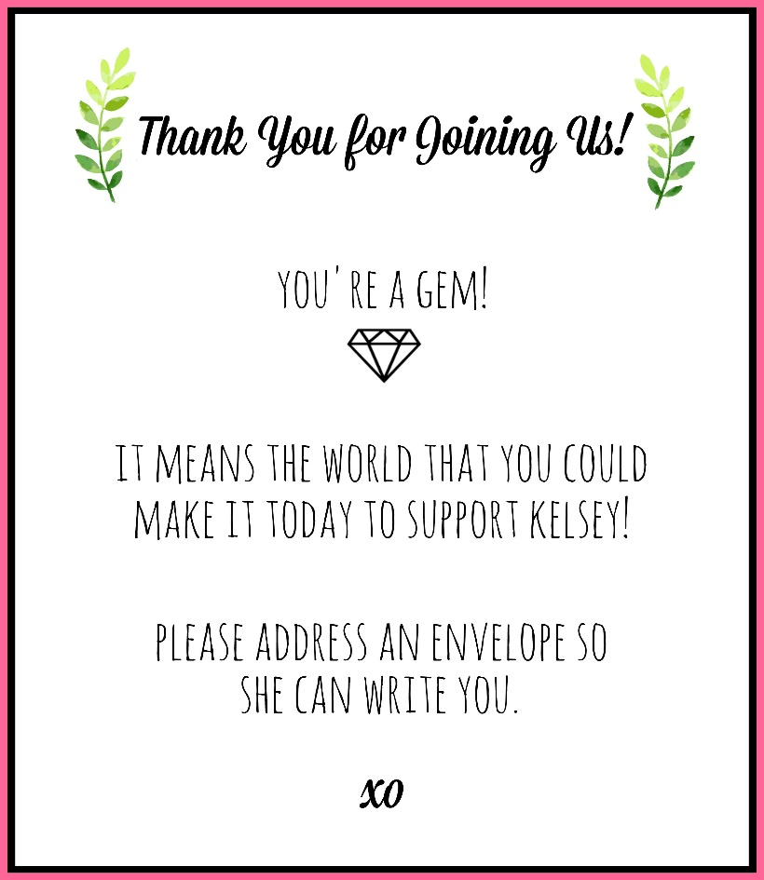

Slide 31


Slide 32


