Slide 1
Stress Reduction Tool Bag

Slide 2
Real Facts About Stress
All stress impacts our life: big and small
Being consumed by technology increases our tendency to feel stressed
70% of Americans admit to “feeling stressed” during the workday
Stress can trigger and flare many health conditions
The risk for a heart attack goes up to 21 times higher in the weeks surrounding a traumatic event, like the death of a loved one
75 percent of healthcare costs are associated with chronic illness — and stress is the No. 1 cause of chronic illness
Being "stressed" is becoming the new normal
Avoid your seasonal cold — avoid stress!!
Notes:
Information and statistics taken from: www.businessinsider.com
Us news and world report
And the American Psychological Association
The idea is that we need to nip in the bud that “don’t sweat the small stuff” is not relevant in our life. Worry is worry! This seminar is geared to be very practical, very hands on, and we are encouraging people to recognize that it’s a process to learn to handle stress better.
We are encouraging audience to look at one or 2 suggestions of changes– small changes we make, can make a difference.
Technology: A British study shows that the more people check their smart phones, the more stressed they become.
Workers who were cut off from office email use for five days experienced more natural, variable heart rate

Slide 3
What Does the Newest Research Say?
Top Stressors in the US
Job/Work
Finances
Health
Relationships - This includes death, illness, divorce, gaining a family member, arguments, being lonely
Nutrition
The media and how it affects us
Sleep issues
Notes:
Source: Top US Stressor’s- research and facts taken from a study done in 2012 by the American Psychological Association, American Institute of Stress
Things like continuous news coverage of event like going over the “financial cliff” exacerbate stress levels.

Slide 4
Objectives
How do you know when you are stressed?
Notes:
We are excited that this class is different, in today’s world, we know a lot more about handling stress than we did just a year ago. Things we “used” to do like closing our eyes and counting to 10 do not necessarily work anymore…at least not for everyone.
We all live complicated lives… which include the ever changing economic situations, finding work life balance, death, illness, etc… all of these life events demand that we all have our own stress management tool bag. A tool bag to help get through the stressful events that we face.
For managers ask: “What sorts of stressors are your clients/callers bringing to you these days?”
At the end of the seminar it is our goal that you will have a tool bag full of tools to pick from. Tools you can use depending on the stress going on in your life.

Slide 5
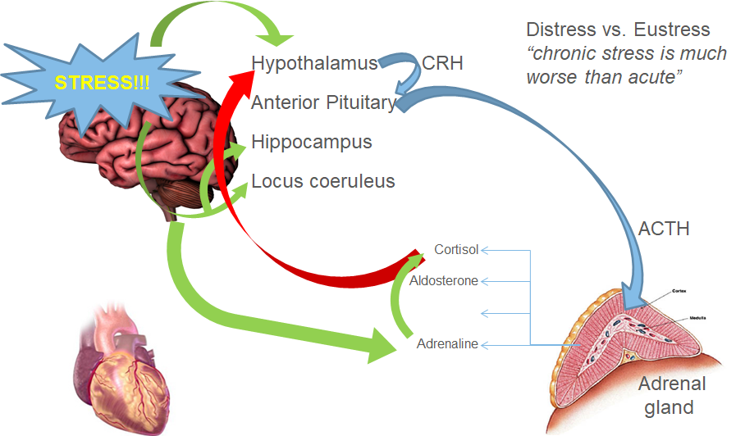
Notes:
A quick look at how stress affects our body physiologically. Here we are talking about Eustress, the good kind. Upon stress, your hypothalamus releases corticotropin-releasing hormone, which stimulates your anterior pituitary to release adrenocorticotropic hormone. The bottom line is that stress causes the brain to cause your adrenal gland to release cortisol. You may have seen this in the papers about 5 years ago as “the stress hormone.” Cortisol is released alongside adrenaline and aldosterone. The overall goal here is the “flight or fight response” that prepares your body to tackle and get rid of that stress. When cortisol levels get high, it feeds back to the brain to shut the pathway down, once the stress is over.

Slide 6
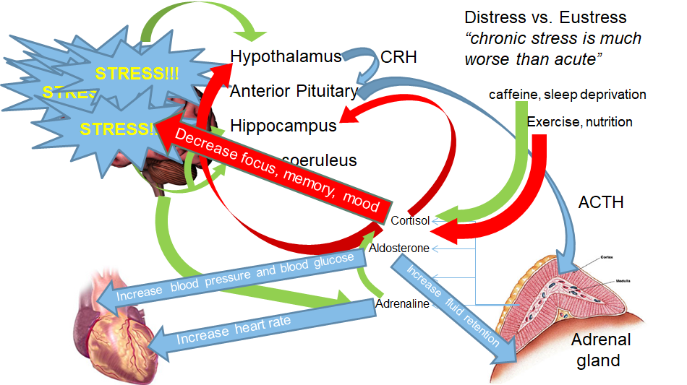
Notes:
The neuro-chem visuals are meant to be fun!!! It’s a visual to allow you to wrap your head around chemicals and chronic stress.

Slide 7
How You Know You’re Stressed
Trigger happens, endocrine system responds with increased adrenaline and cortisol
Body ready for action
Heart pounds faster
Muscles tighten
Blood pressure rises
Breath quickens
Senses sharpen
Notes:
Example: You were just cut off in your car – what does your body feel like? That is an adrenaline rush?
By using this example, we are highlighting what stress physiologically and mentally feels like!!!
This is a good time to check in with the audience to make sure they understand that everyone's body is different. Make sure they know what it feels like to them! It is important to note that some people are very good at disguising their facial expressions and we often don’t know that the person is stressed because they hide it well.
Discussion:
Ask the group if they think holding in stress is healthy? When is the adrenaline rush a helpful thing?

Slide 8
Good Stress – Bad Stress
Good Stress
The only “stress free” people are deceased
Adrenaline sharpens our senses, Cortisol preps your body for action
Helps us get it done
Bad Stress
If we get too stressed it lowers our immune system
When you push it onto your co-workers or family members
Notes:
This is why an adrenaline rush makes us accomplish a lot –
However our bodies cannot be in this state for long.
How do you know if it is too much?
Stress is very individualized and each individual handles stress differently.

Slide 9
Breakout 1
Turn to your neighbor and discuss what your personal stressors are?
What pushes your button and triggers you?
Notes:
This activity should take 5 minutes and make the point that just as talking about our stressors will help.

Slide 10
Identifying Triggers
Inner Stresses
Comparing yourself to others
Unrealistic expectations
Fear of failure/success
Outer Stresses
Money
Weight
Children
Family
Notes:
Stress is an individual and personal response to our lives and lives around us.
This seminar is going to be focused on how to handle life stressors and creating the tool bag to help us!
Stress is both acute- set off by independent events, and chronic- things we carry with us during the day that we might not be aware of, or try to not think about.
If possible with admins make an easel list of Inner and Outer stressors
This class mostly focuses improving stress management by “changing your mind”, however there are some stressors—e.g. money—where people may need to do more than just personal stress management techniques. It is important to note some stressors are harder than others to handle so having a variety of ways to respond, “toolbag”, is really useful.
We’ll be talking about each of these later in the presentation”

Slide 11
How to Know When Others are Stressed
Visible stress responses can be broken down into 3 categories:
Person A: You can’t always tell when this person is stressed. There are no apparent physical or emotional responses
Person B: This person may seem a little off. They could be overreacting to small things and are acting differently
Person C: This person reacts to stress in obvious ways like weight gain or overreactions in common situations
How much someone visibly reacts to stress does not necessarily correlate with how stressed they are
For those who are not visibly stressed, it is important to acknowledge that there may be reason for stress and to ask how they are doing
Notes:
Our ability to read people is known as social intelligence.
It is important not to judge someone for how they react to stress and what their stress load is. Instead, it is up to us to get more attuned to others.
One idea to practice this is to spend a day at a coffee shop observing people and how they react and interact. This is especially good to begin to understand people who are the least like ourselves.
Parents and teachers need to recognize increasing stress in children. Think about the challenges people with Asperger’s face.
Note: A parent being aware of how their child responds to stress is critical and could even save their life.
Person A: You can’t always tell when this person is stressed
No apparent physical or emotional responses
What’s the best way to find out if someone who isn’t showing it might be feeling stressed?
Person B: This person may seem a little off. They could be overreacting to small things and are acting differently
What’s the best way to approach someone who is demonstrating by their behavior that something might be bothering them? How can you be certain something’s up before talking with them? How might you best approach them to maximize the chances that they’ll be willing to hear what you’re saying? (Techniques for empathy, noting you’ve been through similar things, offering support)
Person C: This person reacts to stress in obvious ways like weight gain or overreactions in common situations (understanding that long-term responses, like weight gain or ulcers, are very different from short-term responses, which often involve visible behavior changes)
How much someone visibly reacts to stress does not necessarily correlate with how stressed they are (much of the reaction is internal, but more, we all differ in our “fuses”—some of us may react very strongly, and immediately, to what might seem like a minor stressor, while others may appear to take a long time to react to what may appear a serious stressor)
For those who are not visibly stressed, it is important to acknowledge that there may be reason for stress and to ask how they are doing (this may allow someone who is able to ‘hide’ their reaction to acknowledge it, and ask for assistance)

Slide 12
Tool Bag
“Mindful communication”
Breathing
Check ups and check ins
Nutrition
Friends and family – support system
Distract and Deflect
Organize
Stop trying to keep up with the Jones
Notes:
Mindful communication - saying what you mean carefully and thoughtfully -- it means you don’t let your words get the best of you. Words can make one feel better, but they can also make us feel a lot worse! Be careful what you say!
Breathing - taking just a few simple deep breaths can be helpful - this is a real form of relaxation. Remember that when you are stressed, breathing gets rapid and shallow. You want to reverse this, consciously breathing slowly and deeply. There are numerous useful breathing exercises that can help such as deep cleansing breaths.
Check ups and check ins: This is an important point, stop and take some time to discuss this one.
Paying attention to how/what we’re feeling is crucial, though often difficult. Men can especially fall back on “I’m fine” when concerned friends and co-workers ask how we’re doing—and women aren’t immune, either. A “check-up” can be an official one, where medical professionals can monitor our blood pressure and cortisol levels in our blood. A “Check-in” is both asking ourselves how we’re doing, and welcoming input from others about how they’re seeing us. Close friends, co-workers and relatives often realize something is going on before we do, and giving them—specifically—permission to give us feedback can really be useful.
Sometimes you feel like you are ok… and you feel like you are handling your stress, and going along with life but in reality you are not! You are stressed and burned out and don’t even check in with yourself to realize this. Ask yourself: How am I doing? Reflect… and always check in with others… welcome feedback!
*Example: When your organization is going through a big change we go into crank mode… but sometimes that makes the situation worse. Not always the best solution - stop, check in, and reflect on what's going on and how you respond to it.
Nutrition - it is important to be aware that what you eat truly can help you deal with stress. Tips include limiting alcohol and carbs and increase fruits and vegetables.
As with exercise, most of us know what we need to do, and few of us do it. The classic “five servings daily of fruits and vegetables” is accomplished by fewer than one in five of us. Stress often involves overwork, or compounding family responsibilities that don’t allow us the time that is important for eating, both what we eat and how we eat. Fast food is just that—fast. But often is high in carbs and fats and salt, all of which can contribute to poor health and stress. Radical diet changes tend not to work, so this needs to be a “baby steps” process, gradually cutting back on the foods that inhibit good health and promote stress, while replacing them with nutritious foods.
Support System: Maybe you need to make conscious decision about who is in your life - to evaluate and avoid those who bring you down, stress you out – those who are a bad influence, negative, difficult people. Especially stay away from these people during difficult/stressful times. Surround yourself with a
reliable support system!
Distract and Deflect - please highlight this one with participants, it is a new and highly proven tool to put in your “stress tool bag” Distraction is where we give you permission to not think about a certain stress for the next hour, day or week. You consciously choose to not think about it. This is vastly different than denial, which says I am never ever going to think about it. It’s just placing it somewhere else for a short amount of time. A benefit of this is it allows our brain to take a break which very often reveals solutions to problems.
Give participants a real life example of distraction!
Organization is a key tool, which includes getting rid of stuff – cleaning out the clutter!!!
In reference to Stop Trying to Keep up the Jones. One effective technique for this is to take a few minutes each evening, as you prepare for bed, to make a list of goals — including work goals—for the next day. This does two things: It gives you a list for the next morning, so you’ve begun the day with a clear idea of what you want/need to do; but even more, you may find that it prevents the need to lie awake fretting about tomorrow. And a good night’s sleep is part of the “golden triangle”—nutrition, exercise, and adequate rest. Set realistic expectations. Compare to yourself to you…. Not others!
*Points for holiday season*
Better car or clothes, bigger house or TV, more and better holiday gifts. This is generally a recipe for disaster, since there will always be others with “more and bigger,” and fretting about it can be incredibly stressful. Again, materialism is especially insidious during the holidays, since we know how the media sets children up to skillfully hound parents for that “must have” toy. Finding ways to re-think what the holidays are about can be a truly freeing exercise for families.
Ask the audience: how many of you are perfectionists?
For those that are – its important to identify this because your stress level will be too high. Take away: perfectionism can’t exist - identify and accept that you will make mistakes.

Slide 13
Mindful Communication
Controlling your thoughts
What do you say to yourself when you are stuck in traffic?
How do you handle yourself in heated meetings?
Screening out all negative thoughts- focus on positive aspects
Have a life plan
Notes:
Controlling your thoughts
What do you say to yourself when your stuck in traffic?
Do you focus on being stuck in traffic or look out the window and say ok I am going to focus on the leaves, the colors, sights, weather outside, etc.
How do you handle yourself in heated meetings?
Good time to talk about PREPARATION. If you believe a meeting’s going to get heated, take time beforehand to think about what you might want to say in response to others’ comments.
Screening out all negative thoughts- focus on positive aspects (techniques for this can take quite a bit of time)
Have a life plan - The idea is if I go to work and think about being a good person– having a greater drive than just answering the phone or filling an order, it puts everything in perspective.
Have everyone sit in their chair and show what they look like when they are really stressed. Some are more external and some internal. The millennial group tend to show it more and speak about it more to others- examples are Facebook where many posts their stressors for the public to see.
The first step in controlling your thoughts is “rewiring” the way you look at a situation.
In a 2008 study in brain imaging and behavior – Swimmers watch videos of themselves failing in the Olympics, they were coached to see the failure as a learning opportunity. Their MRI’s changes from negative emotions to positive emotions.
A metaphor to use for “controlling your thoughts” is the idea that our mind is constantly playing “tapes”—thoughts about things that the voice in our heads constantly yaks at us about. Say to participants “if you’re wondering what ‘little voice’ I’m talking about, it’s the one that right now is saying in your head ‘what voice is he talking about’”…that usually does it. Ask if anyone meditates, since it’s about learning how to turn that voice off—very, very hard. We all have tapes, most made long ago, and learning to change tapes, to make new ones to replace dysfunctional old ones, is very useful.
Also talk about “have a life plan,” using the assignment: Create a personal mission statement as a way to keep your life on track, and end up in old age (Erik Erikson’s final state, Generativity). Being able to look back with satisfaction, with “I’ve lived my life the way I wanted to.” A functional mission for each of us is a touchstone that can provide stability in rocky times, easing stress as we move through those times confident our “life plan” is a good one.

Slide 14
What the Experts are Saying….
Don’t spread yourself too thin – it’s ok to say NO and to be honest about your availability
Ask for help
Focus on what's important
Don’t demand perfectionism from yourself
Exercise: Run, walk, practice yoga, or meditate
Do something every day that you enjoy doing!
Notes:
Self Talk: Turn a negative way of saying something more positive
Example: I can’t do this or I’ll never be able to do this….. I will try to do it, I will do the best I can….
Key: Think or act in a way that you take things one at a time so it doesn’t “stress you out” or overwhelm you!
A good question to ask is “what have you stopped doing, over the past months or even years, that you really used to enjoy?” and “ Could you make time for that again?”

Slide 15
And this, too…
Make sure you are getting enough SLEEP
Unplug
Journal
Breathe
Self talk
Take a walk , take a break, remove yourself from a stressful situation
Notes:
Schedule your break time consciously, and treat it like any other commitment or appointment. Make it something you MUST do during the day.
(The research on productivity and email/smart phones is important.)
Take time out for yourself… me time, alone time to reflect, journal, unplug etc… take that time will make you more productive and focused the rest of the day.
Breathe:
Remember that when you’re stressed, breathing gets rapid and shallow. You want to reverse this, consciously breathing slowly and deeply. There are numerous useful breathing exercises that can help, such as… (6-3-6 or other exercises)
We do about 20% of what we need to do to relieve stress: We know we need more sleep, better nutrition, & more exercise. These add up to the other 80% of what we need to do.

Slide 16
Breakout 2
What works best for you?
What helps you deal with stress?
Notes:
Facilitate a 5 minute exercise with the audience…. Have them discuss what works for them!
Reinforce how important it is for other to share their ideas - sometimes someone else's tool is new and different and will help you to deal with stress!
Ask: What hasn’t worked?

Slide 17
The Key Elements of Stress
Understanding WHAT it is, how it works
Knowing our OWN responses, understanding how we deal with it
And most important, knowing HOW to deal with it
Notes:
The three key elements of Stress are:
Understanding what it is, how it works
Knowing our OWN responses, understanding how we deal with it
And most important, knowing HOW to deal with it
This is where your EAP comes in, with both objectively, with information/content—like this workshop, as well as subjectively, connecting you with professionals who are trained to work with you to assist in getting through stressful situations.

Slide 18
Your Kepro EAPur Kepro EAP
EAP Services available to employees, any household members and dependents
Confidential
EAP Counselors available 24/7/365 via 833-539-7285
Up to 6 in person counseling sessions, per issue, per year, per household member
Management Consultations
Financial/Legal Consultation and Referral Service
Work/Life & Convenience Services
https://sowi.mylifeexpert.com Company code: SOWI

Slide 19
Questions & Answer
Stress Reduction Tool Bag

Slide 20
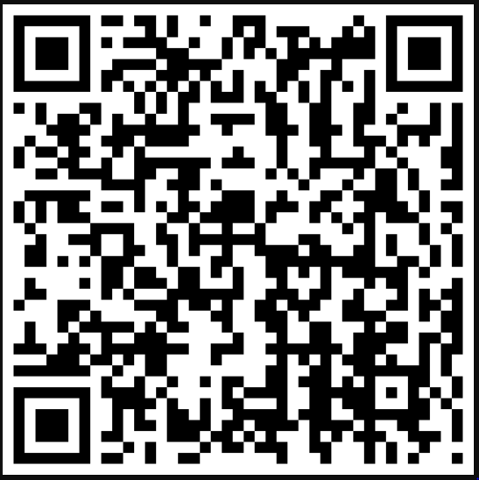
Session Evaluation

