Slide 1
Food Prices, Inflation, and Government Policy:
Understanding Current Events Using Supply and Demand
Professor Norman Cloutier, Director
UW-Parkside Center for Economic Education
Wisconsin Money Smart Week
Green Bay, October 16, 2008
Madison, October 17, 2008

Slide 2
What has been happening to consumer prices?

Slide 3
Overall vs. Core CPI
Notes:
Food and Beverages comprises 14.9% of CPI
Energy comprises 9.7% of CPI
Source: ftp://ftp.bls.gov/pub/special.requests/cpi/cpiri05-06_2007.txt
Note: These values are different than those seen at the USDA site. There may be two reasons for this. First, the USDA is using 1996 data;

Slide 4
World Wheat and Maize Price
Notes:
Source: UN FAO http://www.fao.org/es/ESC/en/15/53/index.html

Slide 5
Percentage of Household Budget Devoted to Food
Country | Food Share
Tanzania | 73.2 %
Vietnam | 64.7 %
Bangladesh | 56.0 %
Japan | 14.9 %
United States | 9.7 %
Notes:
Source: USDA http://www.ers.usda.gov/data/InternationalFoodDemand/

Slide 6

Haiti

Slide 7

Philippines

Slide 8
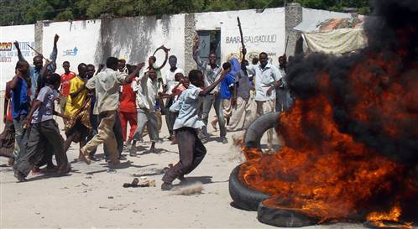
Somalia

Slide 9

Mexico

Slide 10
Economic Forces Behind
Rising Food Prices
The Good. . .
The Bad. . .
and the Ugly

Slide 11
Demand and Supply Shifters
Demand | Supply
Tastes | Technology
Income | Input costs
Number of buyers | Number of sellers
Price of related goods | Price of related goods
Expectations | Expectations
Government policy | Government policy

Slide 12
The Good
Worldwide economic growth has lifted millions of people out of poverty
Worldwide Poverty
Poverty Measure | 1981 | 2005
Number < $1/day (mil) | 1,528.3 | 869.0
Percentage < $1 day | 41.7% | 16.1%
Number < $2/day (mil) | 2,541.5 | 2,597.8
Percentage < $2 day | 69.4% | 47.6%
Notes:
Shaohua Chen and Martin Ravallion, “The Developing World Is Poorer Than We Thought, But No Less Successful in the Fight against Poverty,” World Bank, Policy Research Working Paper 4703, August 2008.

Slide 13
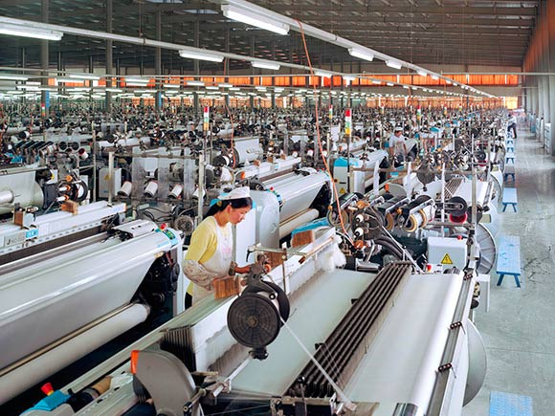
China and India continue to experience extraordinary economic growth
Projected Real GDP Growth Rates
2008 2009
China 9.3% 9.5%
India 7.9% 8.0%
Notes:
IMF Country Information (checked 9/08):
India projected real GDP growth 2008 7.9%, 2009 8.0%
China projected real GDP growth 2008 9.3%, 2009 9.5%
Rapid income growth was probably not a major contributor to rising world food prices, as China and India have been net grain exporters since 2000. However, it has contributed to rising oilseed prices. Source: World Bank, July 2008, p.14.

Slide 14
Rising income has increased the demand for food, and changed the diet of people in developing economies.
Price
Supply of Food
P₂
P₁
D’
Demand for Food
Q₁
Q₂
Quantity
Notes:
CIA World Factbook
IMF Country Information (checked 9/08):
India projected real GDP growth 2008 7.9%, 2009 8.0%
China projected real GDP growth 2008 9.3%, 2009 9.5%

Slide 15
The demand for food and the short run supply of food are highly inelastic. In the short run, even small increases in demand can cause large increases in price.
Elastic Supply
Inelastic Supply
P
P
S
S
•
•
•
•
•
•
•
•
Demand Increases
Demand Increases
Q
Q

Slide 16
The Bad
Supply shocks have increased the cost of producing cereals
Bad Weather
  Six year drought in Australia
  Flooding in Argentina and the U.S.
Rising Input Prices
  Increase fuel prices
  Increase fertilizer prices

Slide 17
Supply shocks have increased the cost of production.
S’
Price
Supply
P₃
P₂
P₁
D’
Demand
Quantity
Notes:
CIA World Factbook
IMF Country Information (checked 9/08):
India projected real GDP growth 2008 7.9%, 2009 8.0%
China projected real GDP growth 2008 9.3%, 2009 9.5%

Slide 18
The demand for food is also highly inelastic. In the short run, even small decreases in supply can cause large increases in price.
Elastic Demand
Inelastic Demand
P
P
Supply Decreases
Supply Decreases
•
•
•
•
•
•
•
•
D
D
Q
Q

Slide 19
The Ugly
Government policy has contributed to the hike in worldwide food prices
The US government subsidizes the production of ethanol made from maize (corn).
US refiners using corn-based ethanol receive a $0.51/gallon subsidy from US taxpayers.
Notes:
For % of corn crop used in ethanol see the Cattle Network:
http://www.cattlenetwork.com/Content.asp?contentid=230813

Slide 20
Government subsidy increases the demand for corn, directly raising its price. As more land is devoted to corn production the supply of production substitutes, like soybeans, shifts to the left.
Corn
Soybeans
P
P
S
S₁
S₁
P₂
P₂
P₁
P₁
D₂
D₁
D
Q₁
Q₂
Q
Q₂
Q₁
Q
Between April 2007 and April 2008, the US expanded corn acreage 23%, resulting in a 16% decline in soybean acreage, and a 75% rise in soybean prices. - World Bank, July 2008
Notes:
The U.S. expanded maize area 23 percent in 2007 in response to high maize prices and rapid demand growth for maize for ethanol production. This expansion resulted in a 16 percent decline in soybean area which reduced soybean production and contributed to a 75 percent rise in soybean prices between April 2007 and April 2008. -- A Note on Rising Food Prices, The World Bank Policy Research Working Paper 4682.

Slide 21
Corn Ethanol Subsidy Facts
Maize used for ethanol accounted for 70% of worldwide increase in maize production 2004-2007.
    Today about 33% of the US corn crop is used in ethanol production.
      “Filling the 25-gallon tank of an SUV with pure ethanol requires 450 pounds of corn – which contains enough calories to feed on person for a year.” How Biofuels Could Starve the Poor, Foreign Affairs, May/June, 2007.
Notes:
For % of corn crop used in ethanol see the Cattle Network:
http://www.cattlenetwork.com/Content.asp?contentid=230813
35 billion mandate from Runge and Senauer, “How Biofuels could Starve the Poor,” Foreign Affairs, May/June, 2007.
The US accounts for about 33% of global corn production, and 67% of global exports

Slide 22
US Ethanol Production Plans
Energy Policy Act of 2005
Notes:
US ethanol production will increase from 9 billion gallons in 2008 to 35 billion gallons in 2017.
Ethanol production data from Renewable Fuels Association:
http://www.ethanolrfa.org/industry/statistics/#A
The US and Brazil are by far the largest ethanol producers.
In 2007
US 6.5 billion
Brazil 5.0 billion
Euro Union 0.5 billion
“The growth in corn use in ethanol between 2000 and 2004 could readily be accommodated by a market where annual increases in corn productivity were exceeding the increase in corn used in ethanol.” The Role of Biofuels and Other Factors in Increasing Farm and Food Prices, Kraft Food Study, June 2008.
However, the Energy Policy Act of 2005 initiated unprecedented mandates for ethanol consumption.

Slide 23
Other Government Policies Contributing to Higher Food Prices
US $0.54/gallon tariffs on imported ethanol
Conservation Reserve Program
Weak US dollar
Changing world trade policy on food
Notes:
“For example, the International Food Policy Research Institute notes, “. . . China has banned rice and maize exports; India has banned milk powder exports; Bolivia has banned the export of soy oil to Chile, Colombia, Cuba, Ecuador, Peru, and Venezuela; and Ethiopia has banned exports of major cereals. Other countries are reducing restrictions on imports: Morocco, for instance, cut tariffs on wheat imports from 130 percent to 2.5 percent; Nigeria cut its rice import tax from 100 percent to just 2.7 percent” (von Braun, 2008b, p. 2). Generally, these actions include reducing import barriers, subsidizing domestic consumption, and halting or taxing exports. These actions prevent reductions in consumption that would otherwise be caused by higher prices, and they reduce supplies available to world buyers. The effect of the actions is to transmit increased prices and price volatility to countries that are not insulating their markets.” Kraft Food study
While some crop acreage is expected to be released from the long-term Conservation Reserve Program (CRP) through the normal expiration of contracts and the 32 million acre cap put in the CRP by the 2008 Farm Bill, the quantity of acres that may return to crop production is still likely to be limited. In the fall of 2008 only 1.3 million acres under long-term contracts will expire and be available for 2009 production, and in the fall of 2009, 3.9 million acres will expire and be available for 2010 crop production.

Slide 24
Student Exercise 1
Why are there are significant differences across countries in price and income elasticities of food demand?
Given these differences, what impact will future price and income changes have on people’s lives?
Go to USDA Economic Research Service and find food budget information for 114 countries:
http://www.ers.usda.gov/Data/InternationalFoodDemand/Index.asp?view=PEB#IFD

Slide 25
Example:
Food price elasticity → How sensitive are consumers to rising food prices?
ε_{p}= % ∆ quantity demanded
% ∆ price
Example: US= - 0.082 Bangladesh= - 0. 372
Food income elasticity → How sensitive is consumer demand to rising income?
η= % ∆ quantity demanded
% ∆ income
Example: US= .103 Bangladesh= 0.733

Slide 26
Student Exercise 2
Who exactly gets US farm subsidies?
Go to the Environmental Working Group:
http://farm.ewg.org/sites/farmbill2007/
Find the largest recipients of farm subsidies in your area.
Using demand and supply, model the Conservation Reserve Program.
Notes:
In 2003-2005, 51,871 Wisconsinites received corn subsidies amounting to $738 million.

Slide 27
Example
Largest crop subsidy recipients 2003-2005, by area:
  Wisconsin
    Mitchell Melms, Orfordville ,WI $477,976
  Brown County
    David Stencil, Denmark, WI $190,911
  Dane County
    Kurt Wileman, Edgerton, WI $396,172
Notes:
In 2003-2005, 51,871 Wisconsin beneficiaries received corn subsidies amounting to $738 million.

Slide 28
Student Exercise 3
What effect do rising food prices have on the standard of living in different countries?
Go to USDA Economic Research Service and find food budget information by country and calculate a simple Consumer Price Index.

Slide 29
Example
% of total budget devoted to food:
    US 9.7%
    Bangladesh 56.0%
Current CPI 100= (W_{f})x(P_{f}) + (W_{o})x(P_{o})
    US 100= (.097)x(100) + (.903)x(100)
    Bangladesh 100= (.560)x(100) + (.440)x(100)
Impact of 100% increase in food price and 5% increase in other prices
    US 114.2= (.097)x(200) + (.903)x(105)
    Bangladesh 158.2= (.560)x(200) + (.440)x(105)
US standard of living would decline 14.2% while the Bangladesh standard of living would decline 58.2%
  2007 GDP per capita:
    US $45,800 price adjusted= $40,105
    Bangladesh $1,400 price adjusted= $885
Notes:
CIA World Factbook:
Bangladesh GDP per capita, 2007= $1,400
US GDP per capita, 2007= $45,800

Slide 30
Questions?
Contact Info:
Professor Norman Cloutier, Director
Center for Economic Education
University of Wisconsin-Parkside
900 Wood Road
Kenosha, WI 53406
Phone: 262.595.2572
Email: cloutier@uwp.edu
UW-Parkside Center for Economic Education Web site:
http://www.uwp.edu/departments/economics/cee/

