Slide 1
Student Accessibility Services (SAS)
How to schedule Exams in Accommodate

Slide 2
Log in to accommodate
Access Accommodate by using your user name and password - which is the same as your Ranger Email, Solar Account, and MyChart.
If you experience trouble logging in, go to the log-ins page on UW-Parkside website and reset your password using the Password Self-Service link
https://www.uwp.edu/explore/offices/campustechnologyservices/passwords.cfm
Follow reset directions
Shut down your computer
Try logging in again

Slide 3
Directions
NOTE-> If you need to take your exam on a different day/time than the class, you need to obtain approval from instructor BEFORE scheduling.
1. Click Testing Room (left margin)
2. FYI: The first time using this tool, the two main sections will be blank. They’ll fill in with your “pending” booking requests and “approved” booking requests.
3. Click New Book Request Button at bottom of screen
1
2
3

Slide 4
Directions
4. Choose the course you want to schedule the exam for.
5. Click Check Availability button at the bottom
4
5

Slide 5
Directions
6 This date range is defaulted to 2 weeks out.
You’ll want to enter a single date in both fields to make scheduling easier.
Or you could enter a different date range than what appears.
7. Time range is defaulted. You can leave as is or enter in a time range.
8. Final Exam: Always check NO, unless it is a final exam
6
7
8

Slide 6
Directions
9. SAS created a workaround for scheduling late afternoon exams in the Testing module.
Select YES or No as applicable to the example.
WORK AROUND
9

Slide 7
Directions
10
10. Select 3rd Floor Library (L 3701) for the building
Note for Students who are approved for Kurzweil screen reader:
You will be asked on a subsequent page if you intend to use Kurzweil for the exam your scheduling.
If you want to use Kurzweil for exam, you’ll be using computers in SAS office (D187).
If you don’t want to use Kurzweil, you’ll test on L3.
Make sure to indicate appropriately so SAS knows where to keep your exam.
11. Click Check Availability
SKIP -->
SKIP -->
11

Slide 8
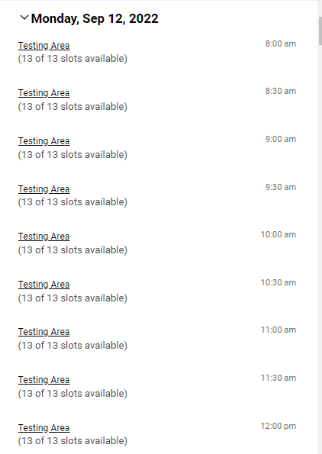
Directions
12. A list of dates (that fall within the date range you selected on the prior screen) will populate on the right side of the window,
13. Click the words Testing Area that correspond with the time you want.
NOTE:
Module is defaulted not to offer a time which extends past the time the testing room closes, which is 4:00pm.
12
13
11
13

Slide 9
Directions
14
14. “Confirm Exam Booking” window will pop up. If you need to start over click the X in the upper right corner of the window.
15. * Indicates required fields you must fill in to continue
16. Enter Instructor’s first and last name. Title not necessary.
17. Check if this is an On-Line exam.
18. Use the right side bar to scroll down through the window.
15
16
First and last name of instructor
17
18

Slide 10
Directions
19. Continue to review window.
20. The module is defaulted to automatically calculate your extended time. It makes the calculation assuming the exam is the length of the class.
The instructor will update SAS with the actual length of time the class is being given when they provide the exam.
If it differs from what’s been calculated, SAS will adjust time.
21. It’s the student’s responsibility to obtain prior approval from their instructor if they are scheduling exam at an alternate time.
22. ALL of your applicable approved accommodations will be listed under “Accommodations Needed”
This example shows 3 accommodations.
23. Please UNCHECK the accommodations you DON’T want to use for this exam or can’t use.
Ex #1: Kurzweil screen-reader can’t read Spanish or Math equations, so uncheck Kurzweil.
Ex #2: You’re approved for Kurzweil but don’t want to use it for this exam, so uncheck it.
19
20
21
22
23

Slide 11
Directions
24. You can free type in the Additional Info Box, whatever you want SAS to know about this exam.
Do not type in what your instructor is allowing for the class (ie: calculator, note card, etc).
Your instructor will provide that information to SAS.
Need to take exam at 8:15.
24
Retest. Need to take exam on ___________ insert date and time

Slide 12
Directions
25. Read The Honor Statement carefully, as you are agreeing to abide by our Academic Code of Conduct whenever you use our proctoring services.
26. Submit request
25
26

Slide 13
Directions
27. After submitting, your request will fall into your “Pending Booking Requests” on your Testing Room Home page.
28. Once SAS approves the request, it will move over to the “Approved” section on the right.
29. Click New Booking Request to schedule additional testing dates.
27
28
29

